Slide 1
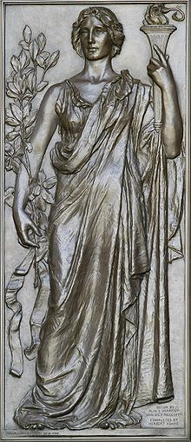
What is Research?
Research helping the torch of knowledge (1896).
Library of Congress Thomas Jefferson Building, Washington, D.C.

Slide 2
Defining Research
The search for knowledge or any systematic investigation to establish facts ^{[1]}
Scholarly or scientific investigation or inquiry ^{[2]}
Research means a systematic investigation, including research development, testing and evaluation, designed to develop or contribute to generalizable knowledge.^{[3]}
Notes:
http://en.wikipedia.org/wiki/Research
http://education.yahoo.com/reference/dictionary/entry/research
45 CFR 46 102(d)

Slide 3
Types of Research
Basic Research
  Acquire new knowledge of the underlying foundation of phenomena and observable facts
  Not directed to particular application or use
Applied Research
  Original investigation to acquire new knowledge
  Directed primarily towards a specific practical aim
Experimental Development
  Systematic work, drawing on existing knowledge gained from research and/or practical experience, which is
  Directed to producing new materials, products or devices, to installing new processes, systems and services, or to improving substantially those already produced or installed.
1. Frascati Manual: http://browse.oecdbookshop.org/oecd/pdfs/browseit/9202081E.PDF
Notes:
. Frascati Manual: http://browse.oecdbookshop.org/oecd/pdfs/browseit/9202081E.PDF
PROPOSED STANDARD PRACTICE FOR SURVEYS ON RESEARCH AND EXPERIMENTAL DEVELOPMENT

Slide 4
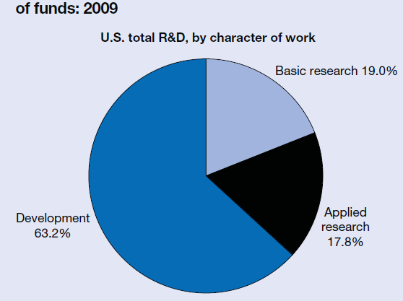
Types of Research

Slide 5
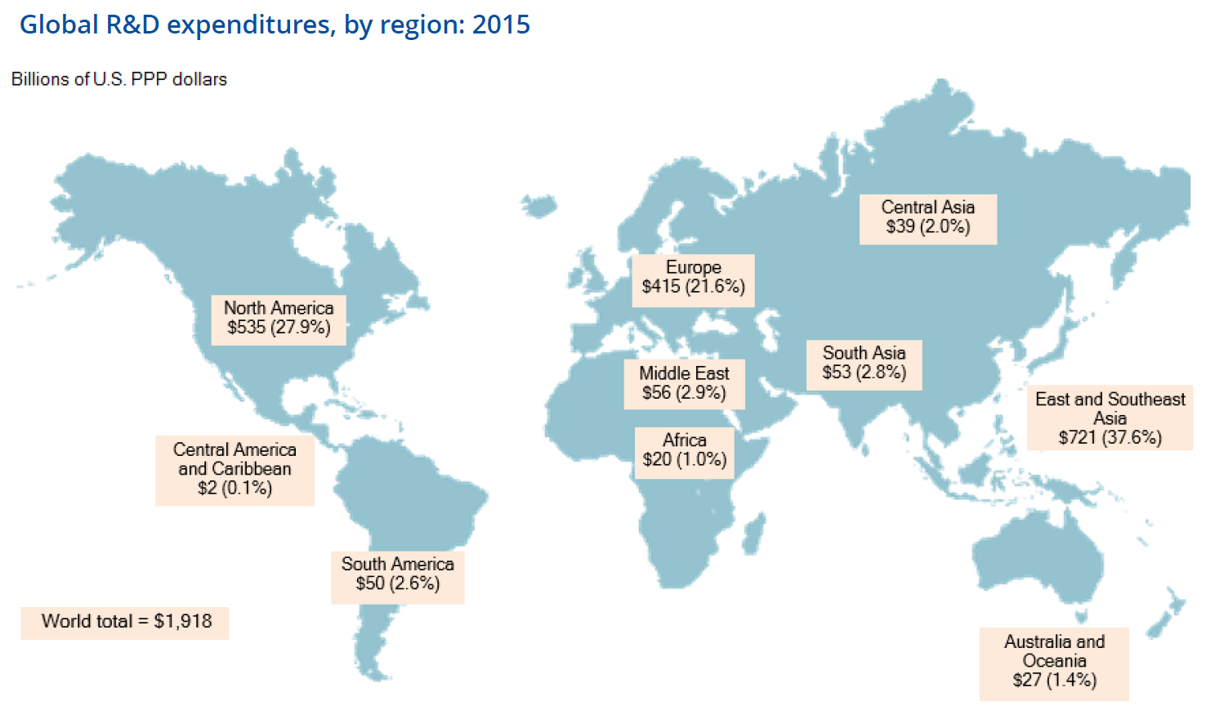
Scope of Research
Notes:
Science & Engineering Indicators 2018
Broad-based, objective information on the U.S. and international S&E enterprise
https://nsf.gov/statistics/2018/nsb20181/assets/nsb20181.pdf
Figure 4-5

Slide 6
Research as a Process
Who Sponsors Research ?
Research
What Does Research Produce?
Inputs
Outputs
Money
Ideas
Needs
Patents
New Knowledge
Products
Companies
Universities
Government Labs
Private Labs
Individuals
Who Performs Research ?

Slide 7
Who Sponsors Research ?
Who Sponsors Research ?
Research
What Does Research Produce?
Inputs
Outputs
Money
Ideas
Needs
Patents
New Knowledge
Products
Companies
Universities
Government Labs
Private Labs
Individuals
Who Performs Research ?

Slide 8
Why is Research Funded ?
Governments - basic research is presumed to be a "public good" whose benefits are shared by all.
Governments – companies won’t fund basic research because it would be shared with competitors
Companies – gain competitive edge
Companies – develop new products
Individuals – intellectual curiosity
Foundations – solve specific problem/disease
Governments - science is so expensive that private funding is insufficient.
Governments - training

Slide 9
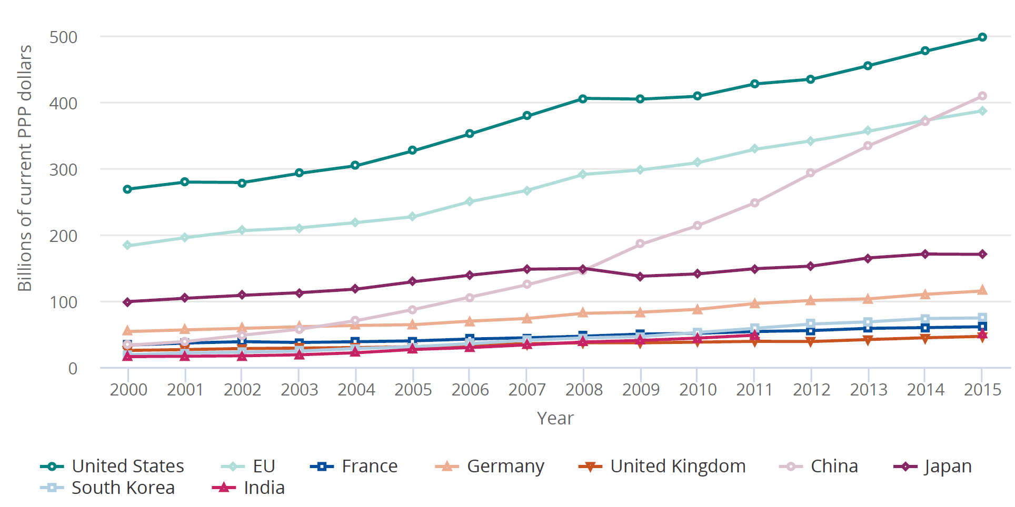
Who Sponsors Research ?
Worldwide Research Funding by PPP Amount
Notes:
Science & Engineering Indicators 2018
Broad-based, objective information on the U.S. and international S&E enterprise
https://nsf.gov/statistics/2018/nsb20181/assets/nsb20181.pdf
Figure 0-6
Normalized to US using PPP (Purchasing Power Parity)

Slide 10
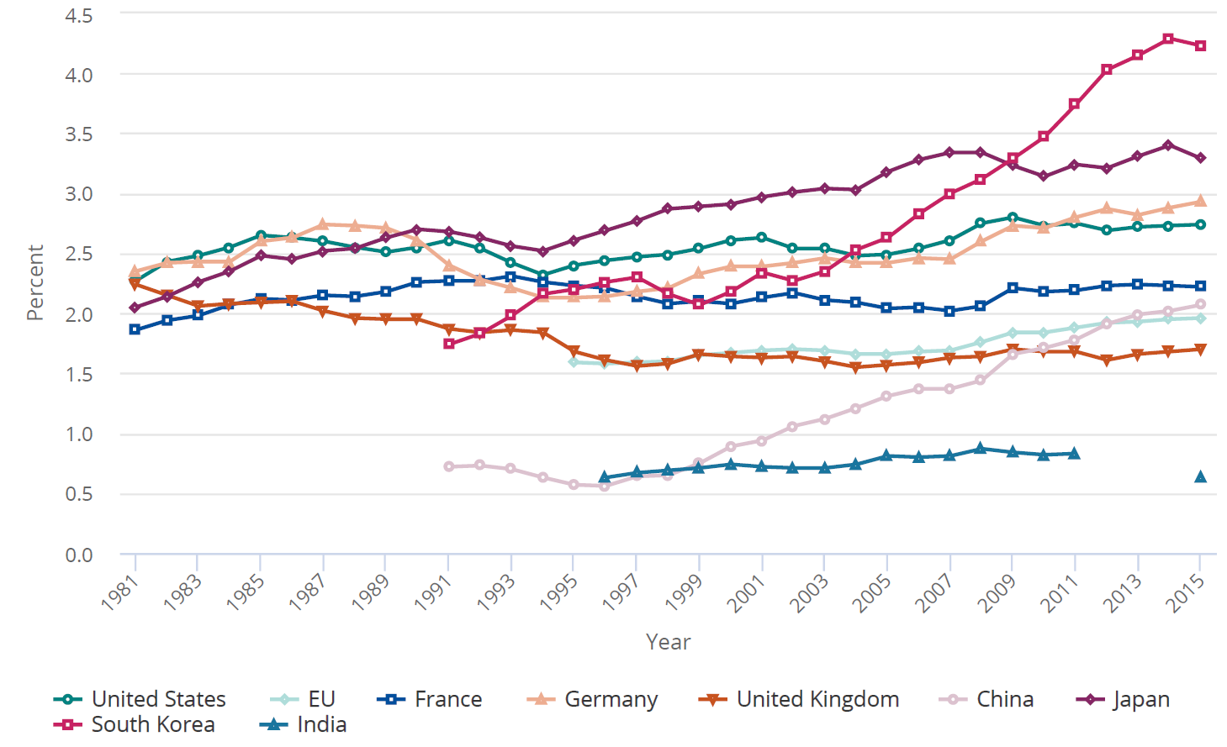
Who Sponsors Research ?
Worldwide Research Funding by % GDP
Notes:
http://www.nsf.gov/statistics/seind12/pdf/c04.pdf plot 4-16

Slide 11
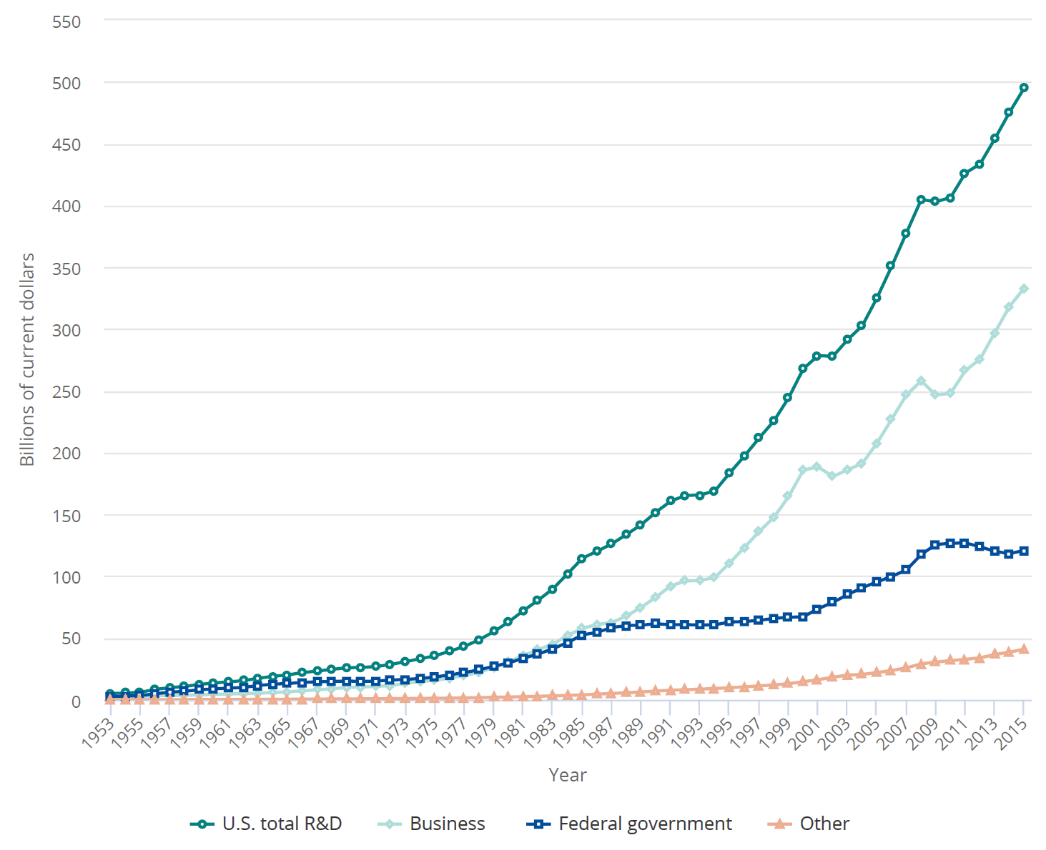
Who Sponsors Research ?
US Research Funding by Source of Funds
Notes:
Science & Engineering Indicators 2018
Broad-based, objective information on the U.S. and international S&E enterprise
https://nsf.gov/statistics/2018/nsb20181/assets/nsb20181.pdf
Figure 4-1

Slide 12
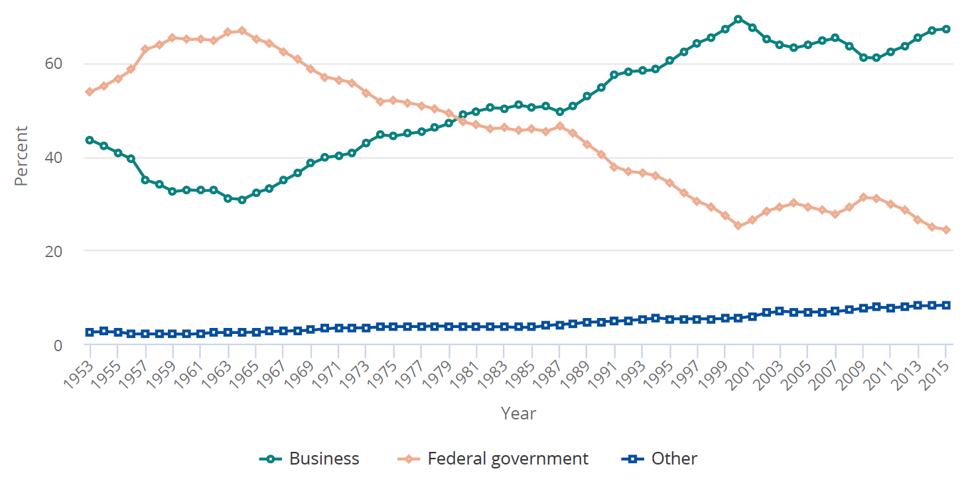
Who Sponsors Research ?
US Research Funding % by Source of Funds
Notes:
Science & Engineering Indicators 2018
Broad-based, objective information on the U.S. and international S&E enterprise
https://nsf.gov/statistics/2018/nsb20181/assets/nsb20181.pdf
Figure 4-4

Slide 13
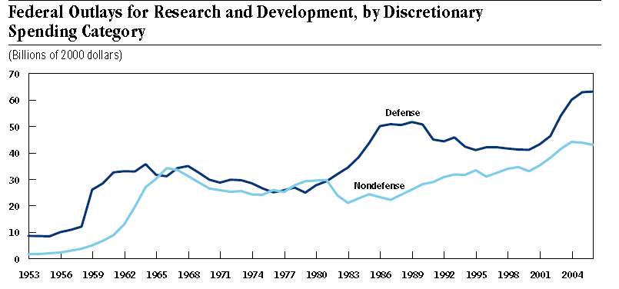
Who Sponsors Research ?
US Government Research Funding
George Bush
President 2001-2009
The Space Race
Sputnik 1 satellite October 1957
Ronald Reagan
President 1981-1989

Slide 14
Who Performs Research ?
Who Sponsors Research ?
Research
What Does Research Produce?
Inputs
Outputs
Money
Ideas
Needs
Patents
New Knowledge
Products
Companies
Universities
Government Labs
Private Labs
Individuals
Who Performs Research ?

Slide 15
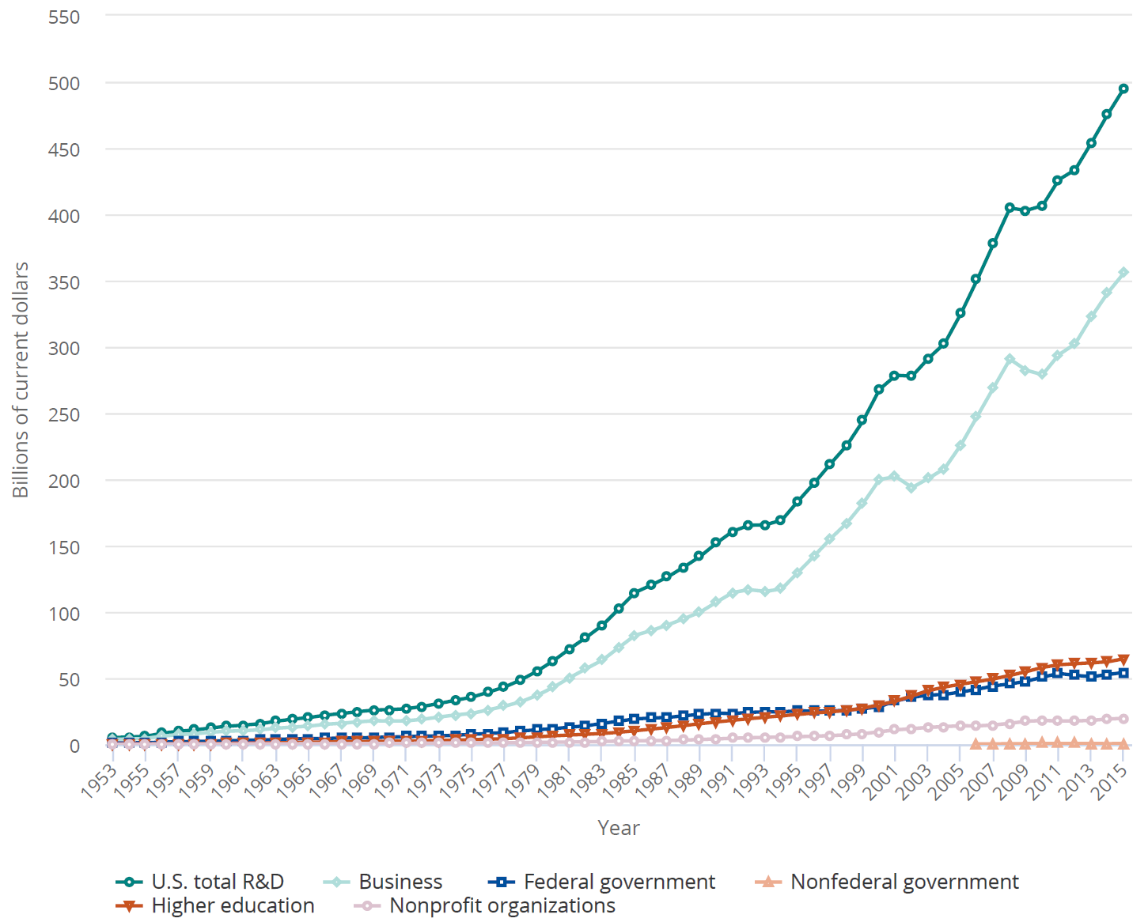
Who Performs Research?
R&D by Performing Sector
Notes:
Science & Engineering Indicators 2018
Broad-based, objective information on the U.S. and international S&E enterprise
https://nsf.gov/statistics/2018/nsb20181/assets/nsb20181.pdf
Figure 4-1

Slide 16
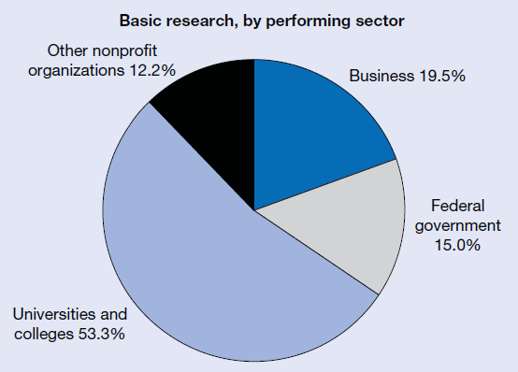
Who Performs Research?
2009

Slide 17
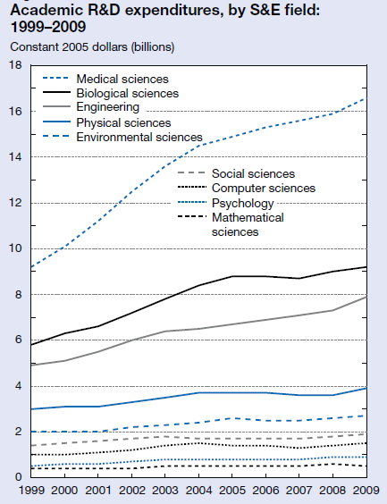
Who Performs Research?
Notes:
http://www.nsf.gov/statistics/seind12/pdf/c05.pdf Figure 5-4

Slide 18
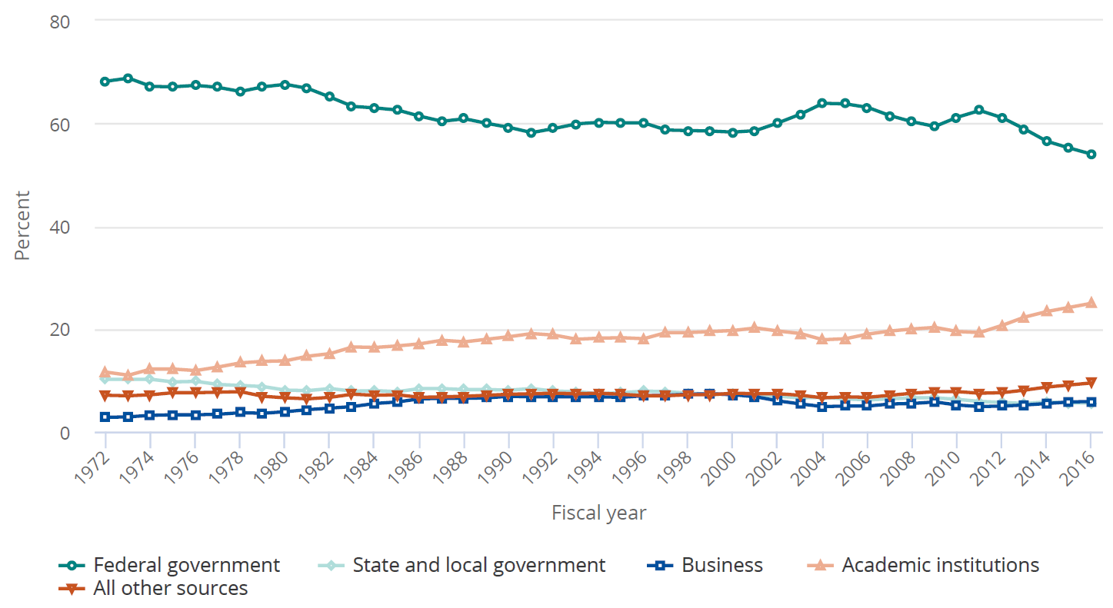
Who Performs Research?
University Research Funding
Notes:
Science & Engineering Indicators 2018
Broad-based, objective information on the U.S. and international S&E enterprise
https://nsf.gov/statistics/2018/nsb20181/assets/nsb20181.pdf
Figure 5-1

Slide 19
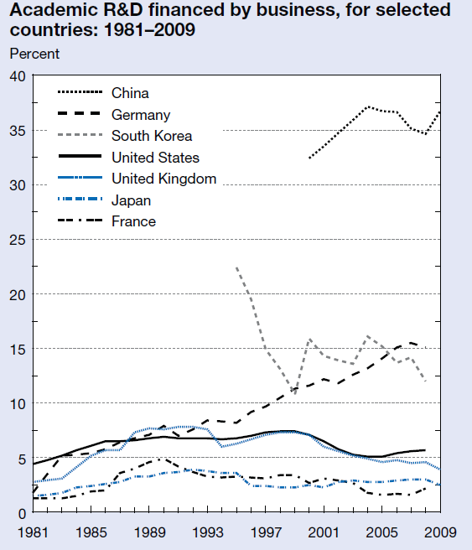
Who Performs Research ?

Slide 20
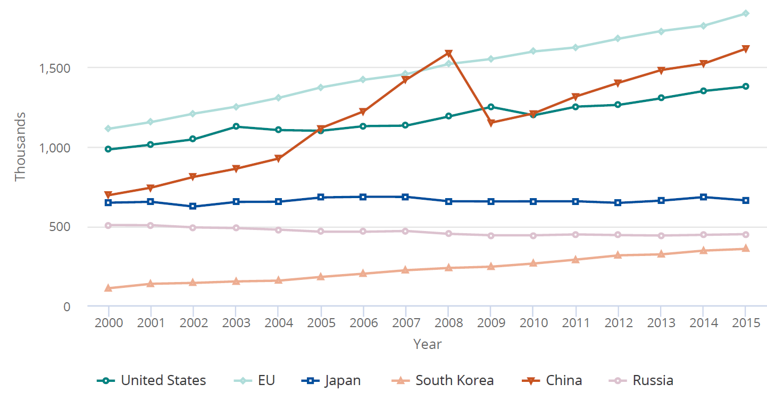
Who Performs Research?
Number of Researchers
Notes:
Science & Engineering Indicators 2018
Broad-based, objective information on the U.S. and international S&E enterprise
https://nsf.gov/statistics/2018/nsb20181/assets/nsb20181.pdf
Figure 0-4

Slide 21
What Does Research Produce ?
Who Sponsors Research ?
Research
What Does Research Produce?
Inputs
Outputs
Money
Ideas
Needs
Patents
New Knowledge
Products
Companies
Universities
Government Labs
Private Labs
Individuals
Who Performs Research ?

Slide 22
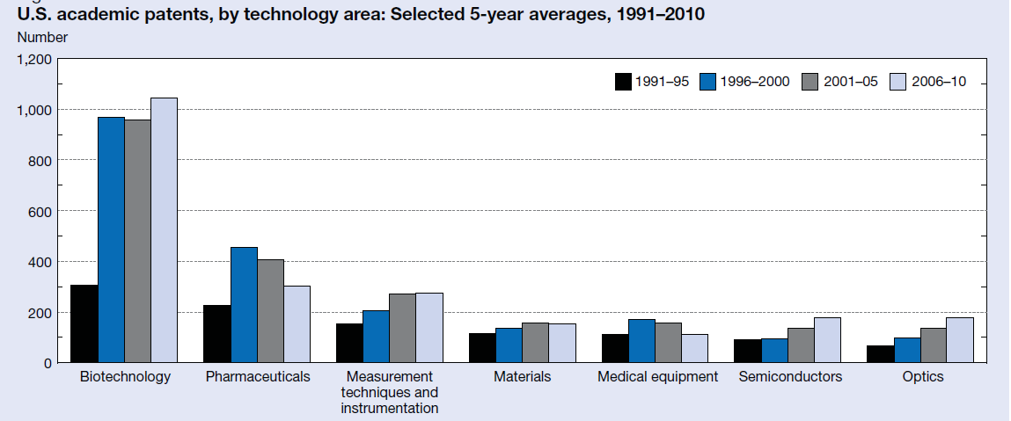
What Does Research Produce ?
Patents

Slide 23
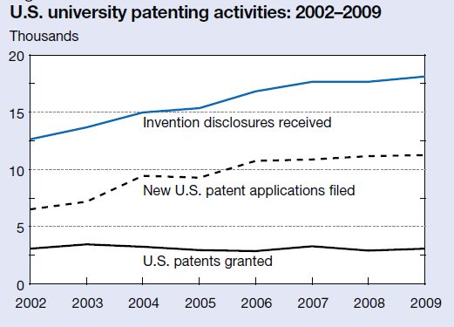
What Does Research Produce ?
Patents

Slide 24
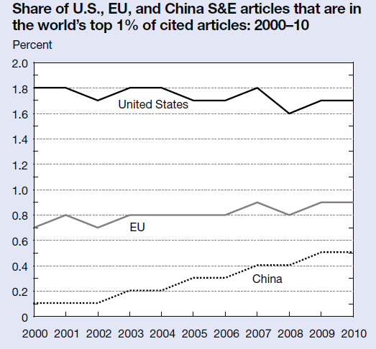
What Does Research Produce ?
New Knowledge
Notes:
http://www.nsf.gov/statistics/seind12/pdf/c05.pdf 5-28

Slide 25
Should Government Sponsor Research ?
Research
Outputs
By US to improve the US
By Britain to improve Britain
By Germany to improve Germany

Slide 26
Should Government Sponsor Research ?
The Economic Laws of Scientific Research by Terence Kealey published in1997
Free market approach rather than that of state funding has proved by far the most successful in stimulating science and innovation.

Slide 27
Should Government Sponsor Research ?
  In the nineteenth century, British science received almost no government support
    Britain grew into the richest and most industrialized country in the world,
    Produced scientists such as Davy, Kelvin, Maxwell, Lyell and Darwin.
    At the same time, France and Germany, whose governments did fund science expansively, trailed behind.

Slide 28
Should Government Sponsor Research ?
  Comparing the Roman Empire with the “dark ages” that followed its dissolution,
    When commerce was under state control under the Romans technical innovation stagnated.
    During the dark ages, when government was weak, all the great inventions that set the stage for the industrial revolution occurred: the saddle, the stirrup, the horseshoe, the horse collar, the tandem harness, the water mill, the crank and several others.

Slide 29
Should Government Sponsor Research ?
Review of institutions that produce the largest numbers of cited papers in biology, of the top seven
  Two were private companies
  One was a charity
  Three were private institutions (though these now receive government grants)
  Only one was a wholly government-founded, government-funded laboratory, the Institut de Chimie Biologique in Strasbourg

Slide 30
Should Government Sponsor Research ?
Hasn't government funding of science produced all kinds of advancements in technology? What about the internet? the various benefits of NASA and the Defense Department?
Response: All of these benefits have been produced through very inefficient means. Private sector firms somehow manage to generate scientific discoveries at a far greater rate than the governments of the world despite having much less money.

Slide 31
Should Government Sponsor Research ?
Myth: basic science is essential for technological advance (it is sometimes essential [electromagnetism]
  science learns from technology [thermodynamics and steam engines]); that
  science is essential for economic growth (technology is, science isn’t);
  and most striking of all, that government supports more science than the private sector would if left to itself.
By comparing different countries, he shows that the larger the fraction of civil science supported by government the smaller the fraction of GDP devoted to science4.
  A dollar of public investment in science seems to displace more than a dollar of private investment.
Notes:
http://psychweb.psych.duke.edu/department/jers/kealey.pdf

Slide 32
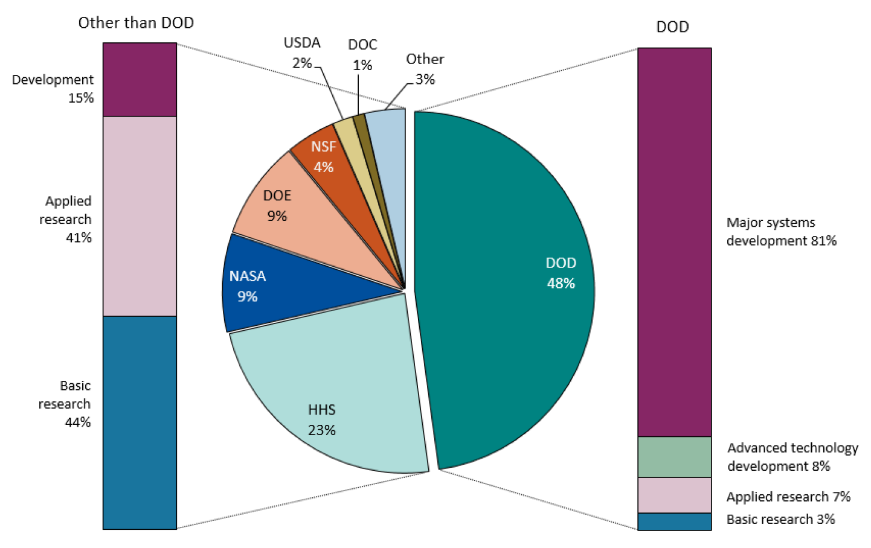
Who Sponsors Research ?
US Government Research Funding
2009
Notes:
Science & Engineering Indicators 2018
Broad-based, objective information on the U.S. and international S&E enterprise
https://nsf.gov/statistics/2018/nsb20181/assets/nsb20181.pdf
Figure 4-11

Slide 33
Should Government Sponsor Research ?
Companies are motivated to do basic research
  Only highly skilled research scientists can capture other people's science.
  The best scientists are those who are actually doing research,.
  To retain their services, companies have to fund them with considerable generosity and considerable freedom.
  Thus we see that "capture" is the solution to, not the problem of, the industrial exploitation of pure research.

Slide 34
Should Government Sponsor Research ?
Most of the benefits of a company's basic science are indeed "captured" by competitors.
Example
  10 largest Japanese pharmaceutical companies, $13 billion revenue
  Each company had an annual return of 19% on its own investment in research
  Each company obtained the equivalent of a 33% annual return on the R&D done by the other nine companies. Each company was, therefore, apparently free riding on the other nine.

Slide 35

Conclusion
We are engaged in the research enterprise

