Slide 1
Make sure this address matches cover letters and correspondence (especially email address)
Second line not centered relative to first line.
Is this a big deal? It is if the reviewer stops reading because they have decided “this person has no attention to detail
Phone Number incorrect
adjective “hands-on” should be hyphenated
Spelling
Grammar “that”
This example is all about what the applicant wants.
Doesn’t address the skills or experiences the applicant would bring to the company.
Employers expect to get a return on an investment in an internship (even unpaid), it is not totally altruistic. This is your chance to show the reader that your background and interests are what they need. They want you to help complete important projects and may be evaluating you for long-term employment after graduation. You should customize this statement for each company and position.
Consider an alternative use of this space. Create a "Summary" statement that collects all of your experiences into a single statement (like an abstract in a journal paper). It is an advertisement that entices the reader to look at the details of your resume.

Slide 2
Does this mean anything to an employer?
Repeated word
“Focused” is not an action word. The first sentence should use simple terms and action words to summarize the experience.
You can be more technical in the following sentences based on the assumption that your resume will ultimately be reviewed by a domain expert. Describe how you used specific tools and procedures (name them) to accomplish a task.
“Enhanced communication skills.” tells nothing about you. Give evidence that you have effectively communicated in a particular setting.
Consider this text:
Designed a clinical assay using a wicking fiber to determine the presence of tumor cells in a patient sample. Learned to use PCR in order to establish that the cancer cells wicked further than normal cells in the fiber. Taught myself MATLABTM image processing tools to automatically capture microscope images of the system. Presented updates at weekly lab group meetings and final results at a university-wide research forum. This experience furthered my desire to learn more about analytical instrumentation.
Note that many would suggest this too long. However, given the few actual experiences of the applicant, they should use the space to describe the depth of this experience. Want a “clean” looking resume not a blank resume.

Slide 3
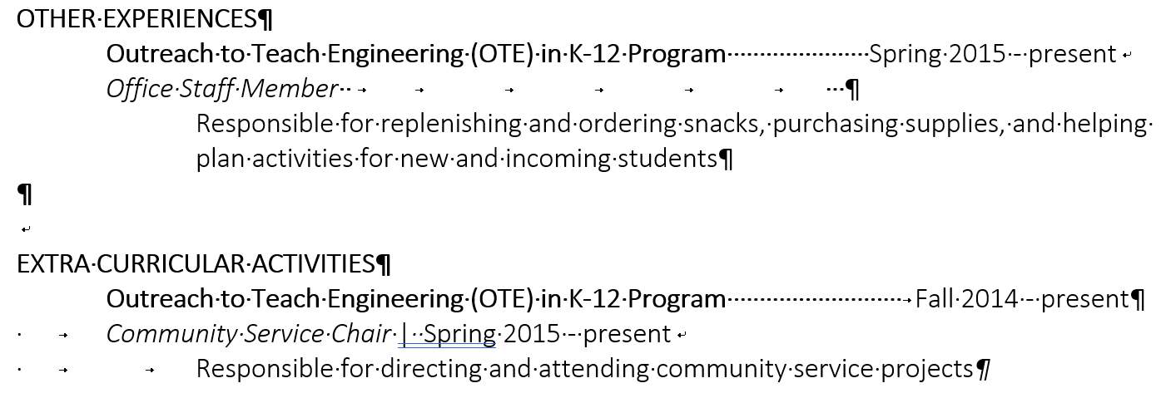
This may or may not demonstrate significant skill, forecasting and order supplies for a large group would be impressive. Need more information.
Inconsistent with use of “.”
This is the opportunity to describe a skill that you have developed and demonstrated here, such as project or time management.
Could you add a statement showing your initiative?
Identified the need for new students to have a one-page quick reference guide and wrote the first draft. All students now get this guide.

Slide 4
Inconsistent with use of bold font
Inconsistent with use of “.”
There is an opportunity to say more about yourself by telling why you were selected. Opportunity to talk about your new skills acquired from the training.
Could you add a statement showing something you learned and then practiced?
During the program I learned about the different personality profiles and how they can each be empowered in a team setting. As the leader of junior design competition team, I organized the agenda for the team meetings to provide everyone the opportunity to give feedback on progress of the project.

