Slide 1

Zotero Guide

Slide 2
Create a (free) Account

Slide 3
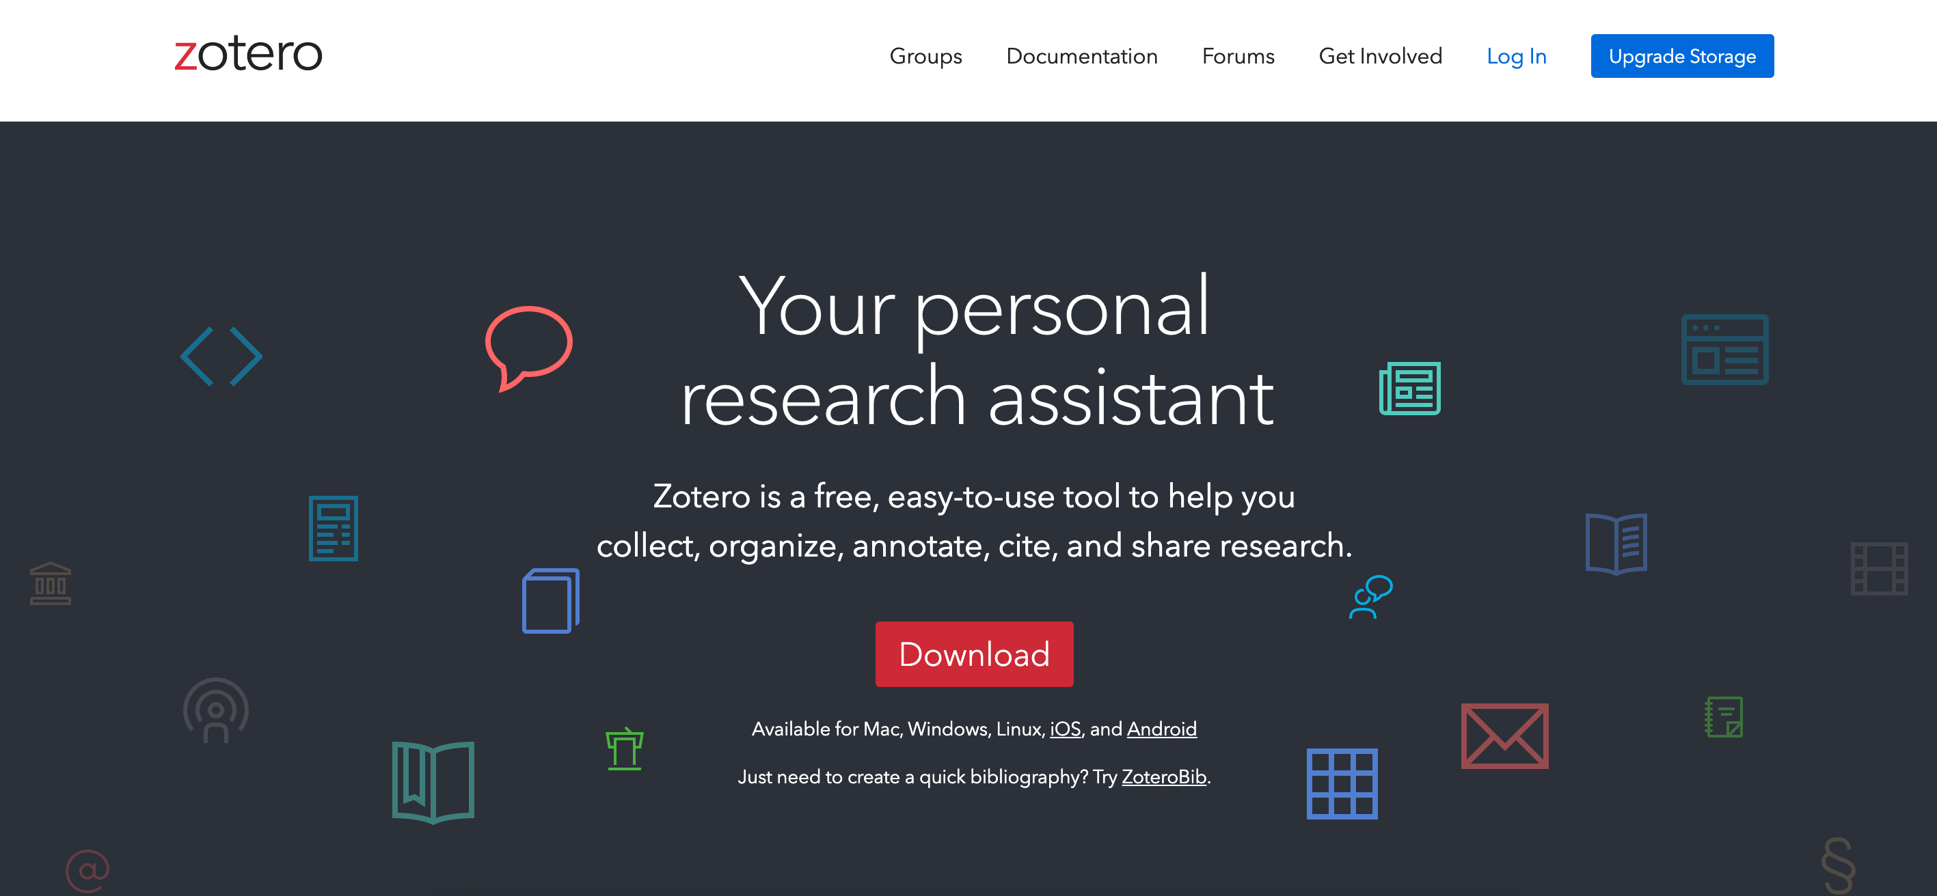
https://www.zotero.org

Slide 4
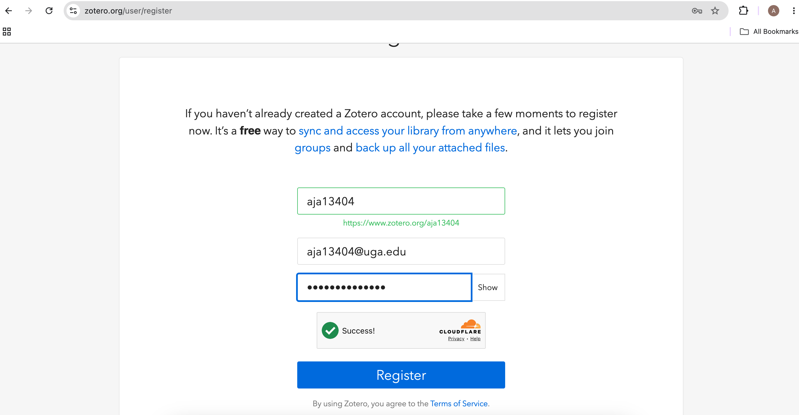
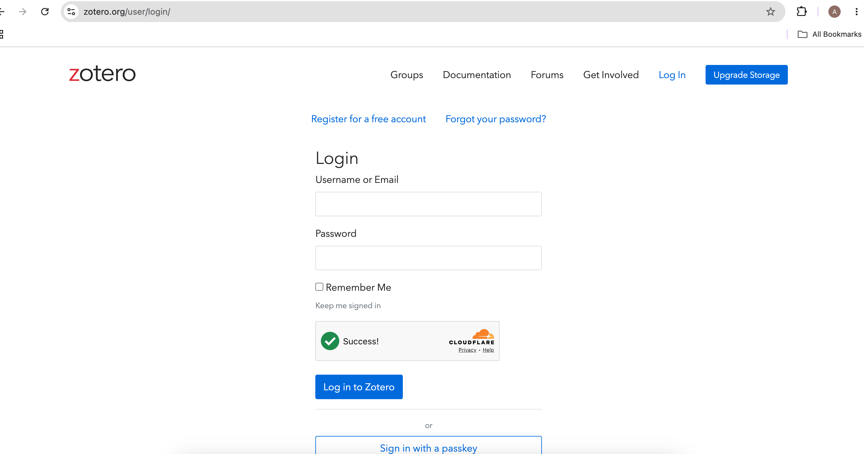
Sign up with preferred email – might want to use personal to maintain access after college

Slide 5
Download and Install
“Zotero”

Slide 6
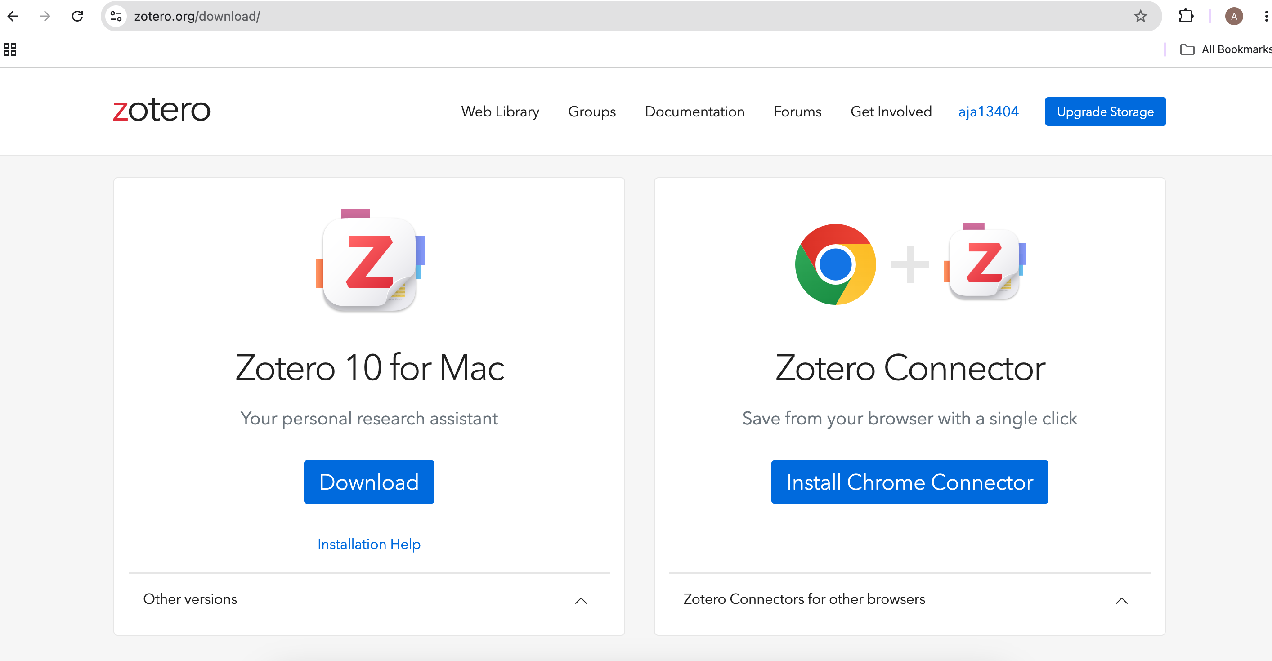
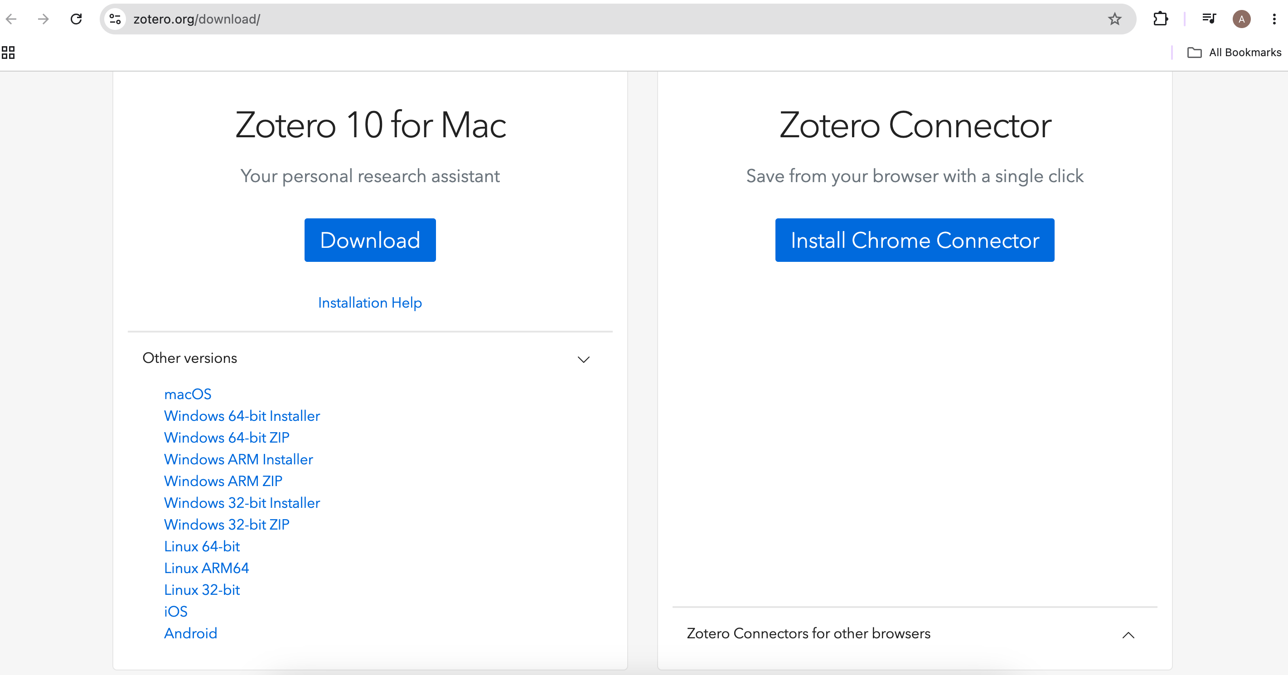
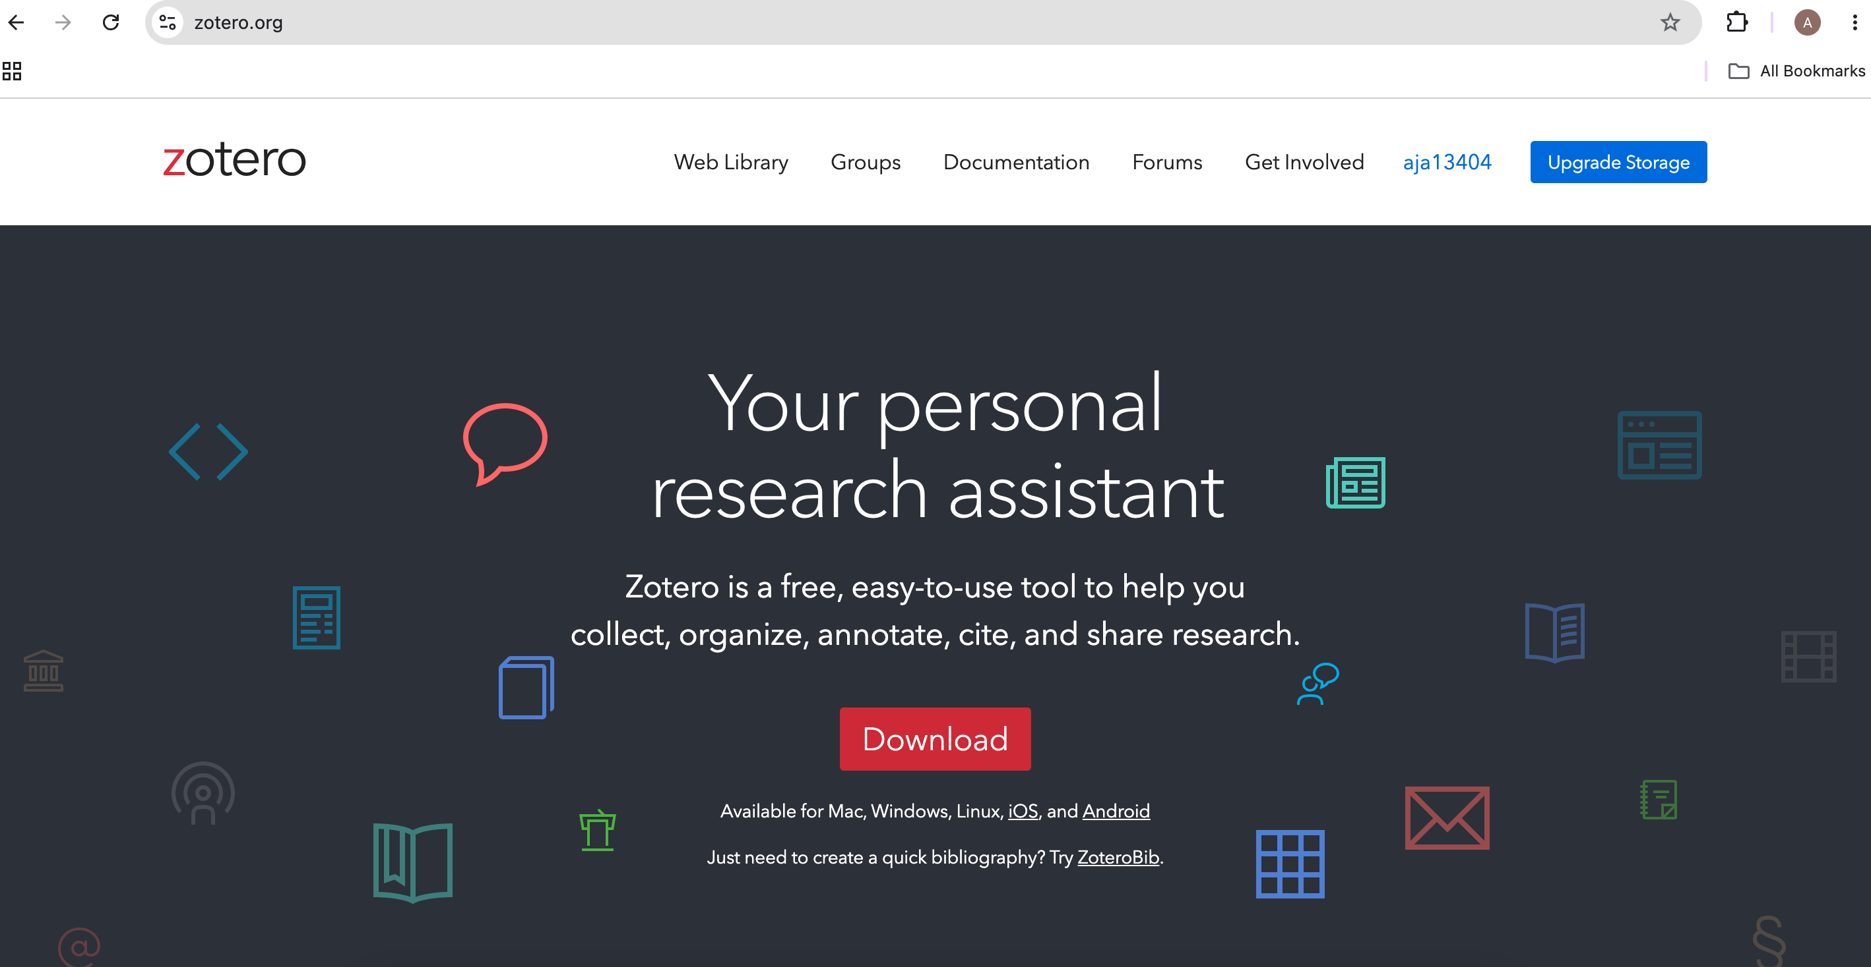


OR If you have a windows/other model

Slide 7
Meet the interface

Slide 8
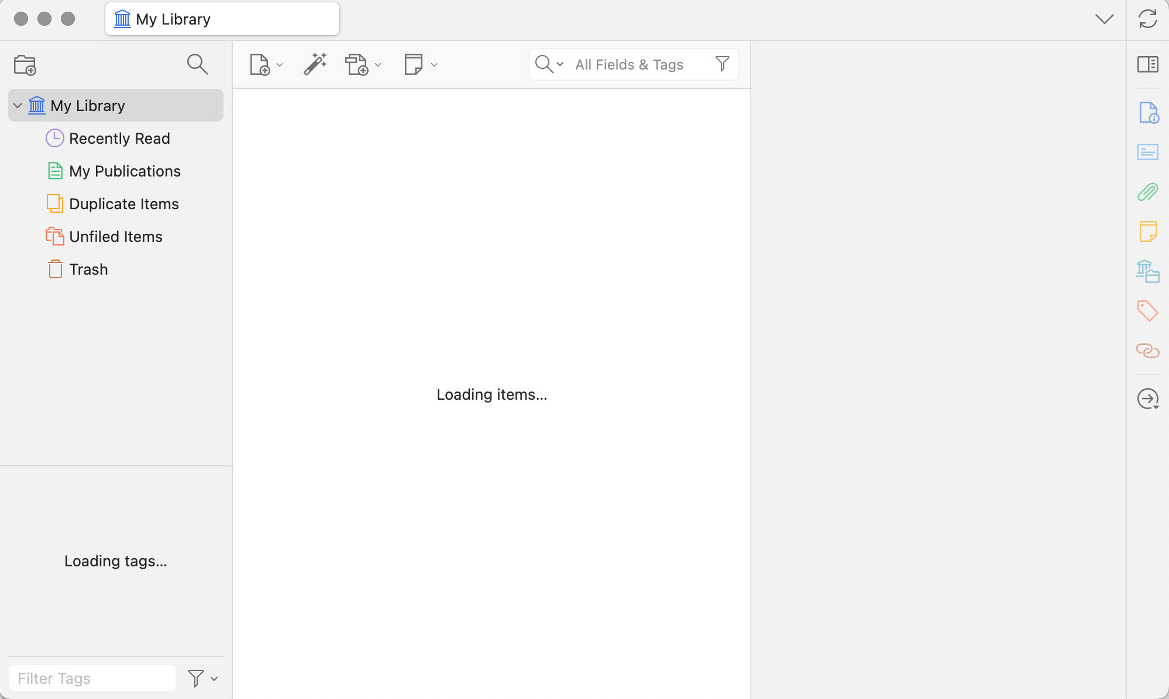

Slide 9
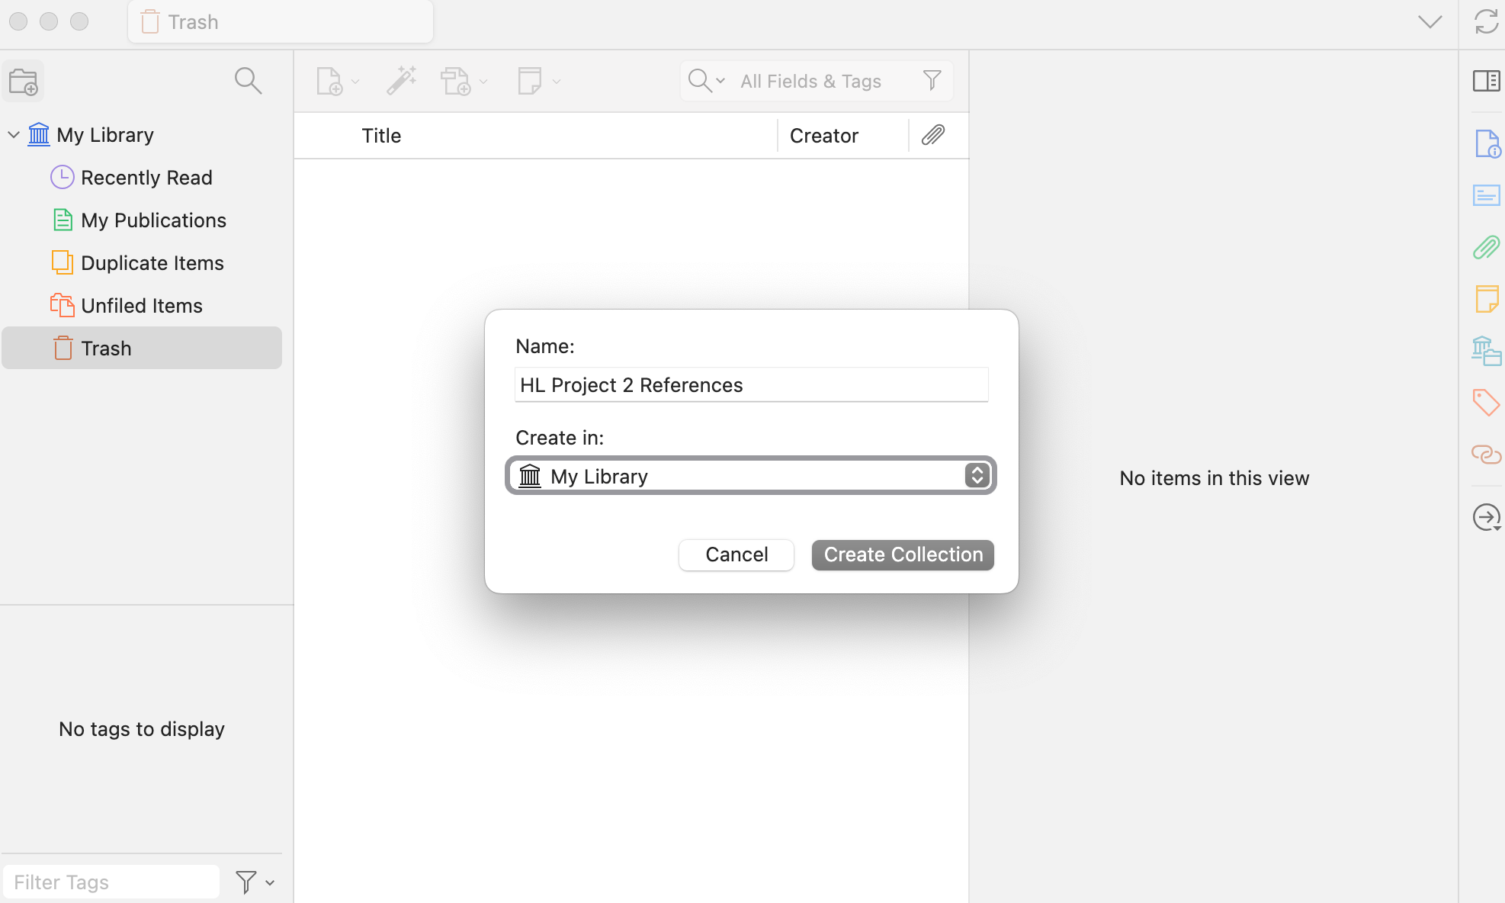
Can add new folders - for example one for your project!

Slide 10
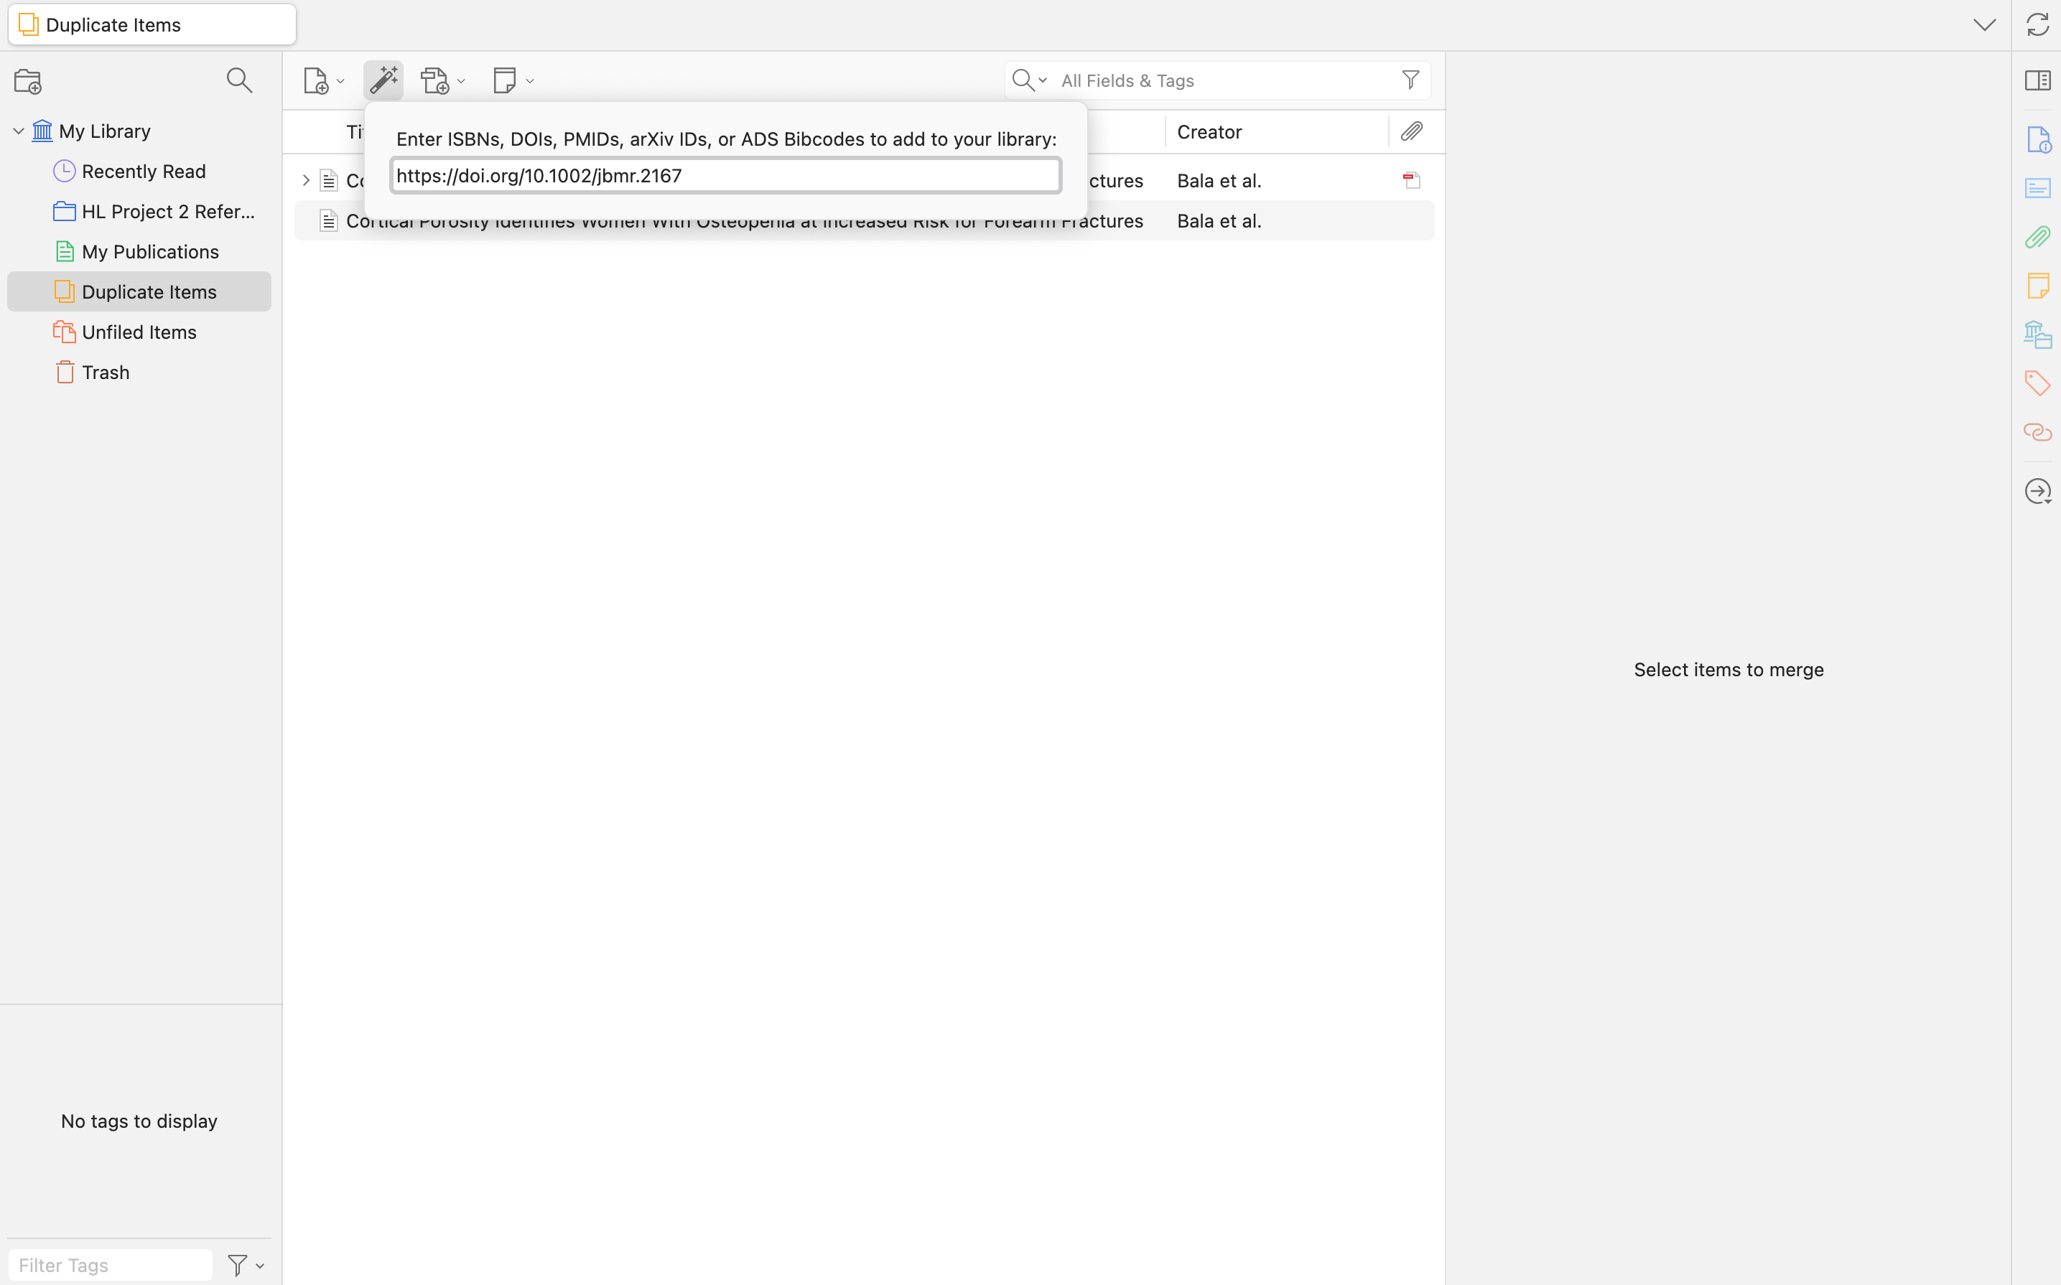
Top Bar Features
Add a new reference
Add a reference with the DIO
Add notes
Add a Saved File/PDF

Slide 11
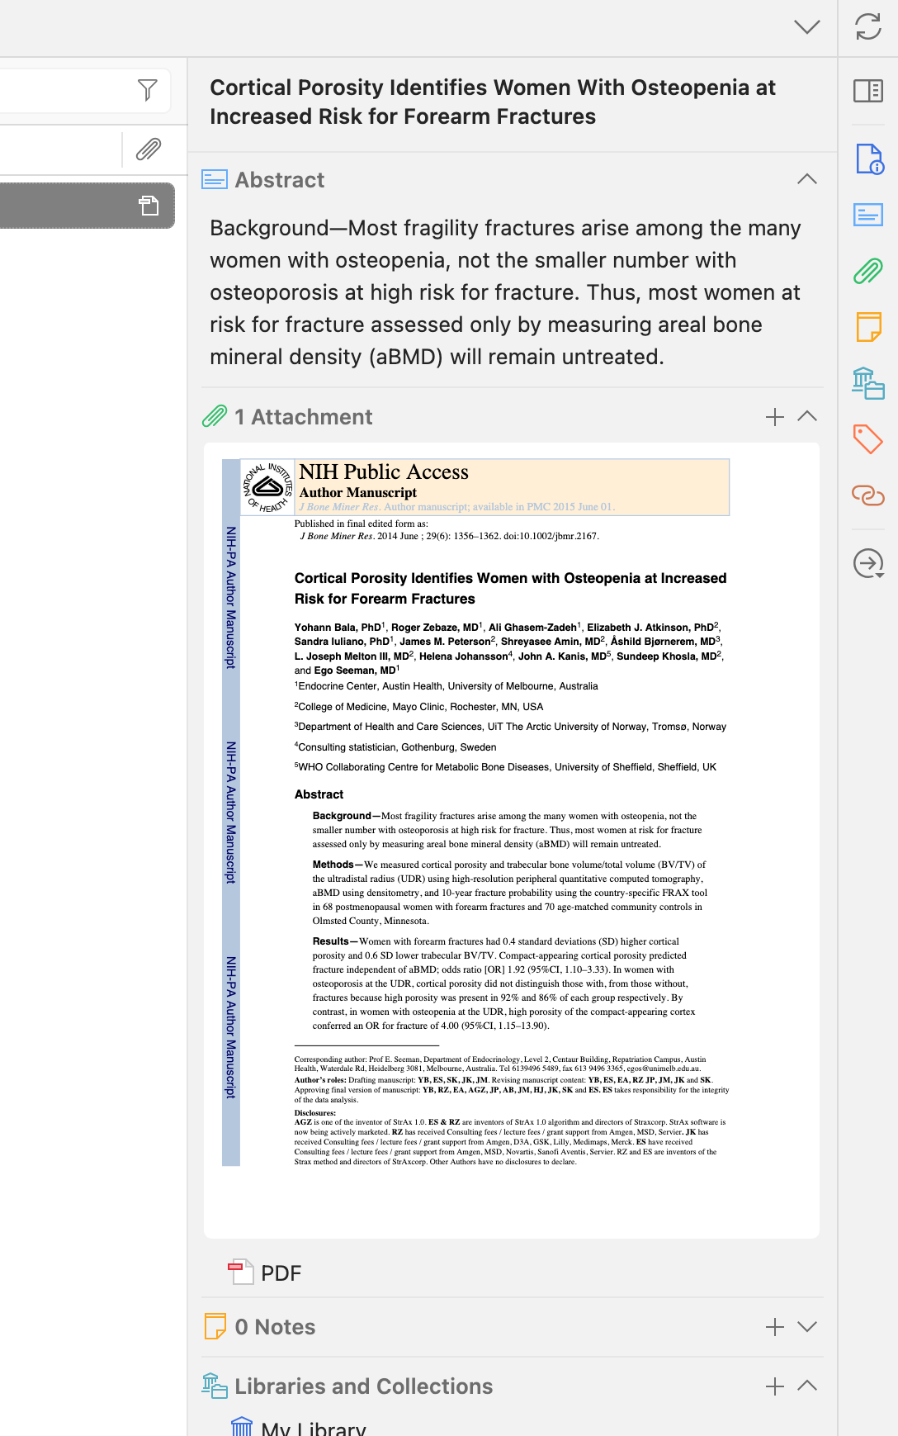
Once a reference is added … the right side showcases quick access to information
Quick access to all the Reference information for citation
Quick access to the Abstract information
Quick access to the PDF linked

Slide 12
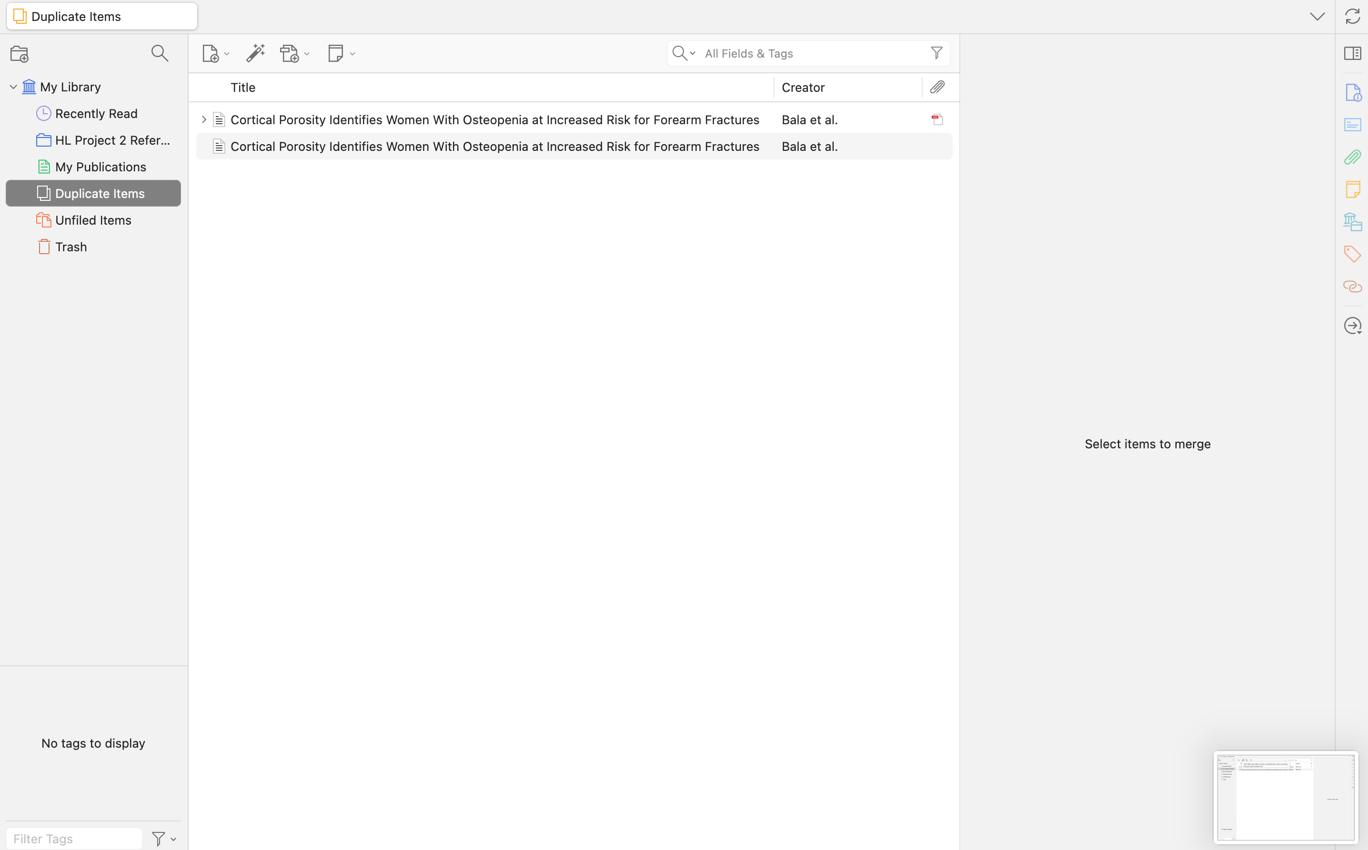
Duplicate references can be found here

Slide 13
Installation of Chrome Connector

Slide 14
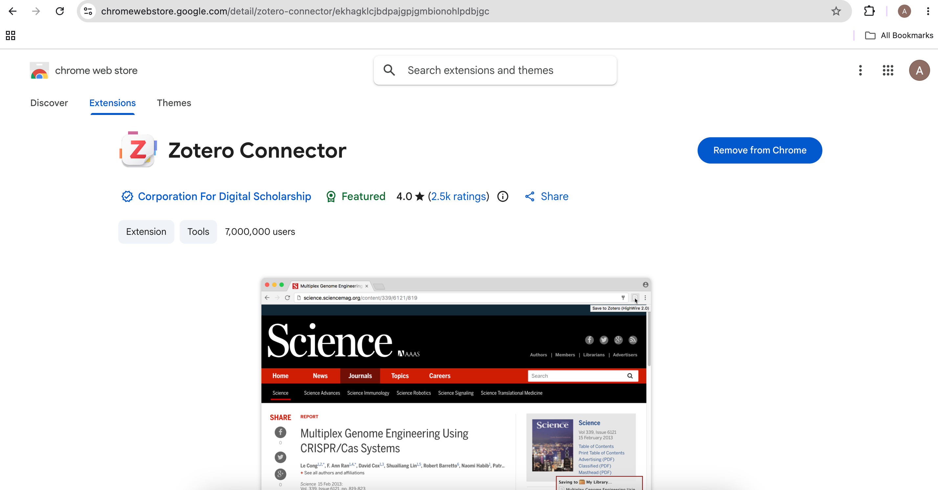
Back to your browser
Will say "Add to Chrome"

Slide 15
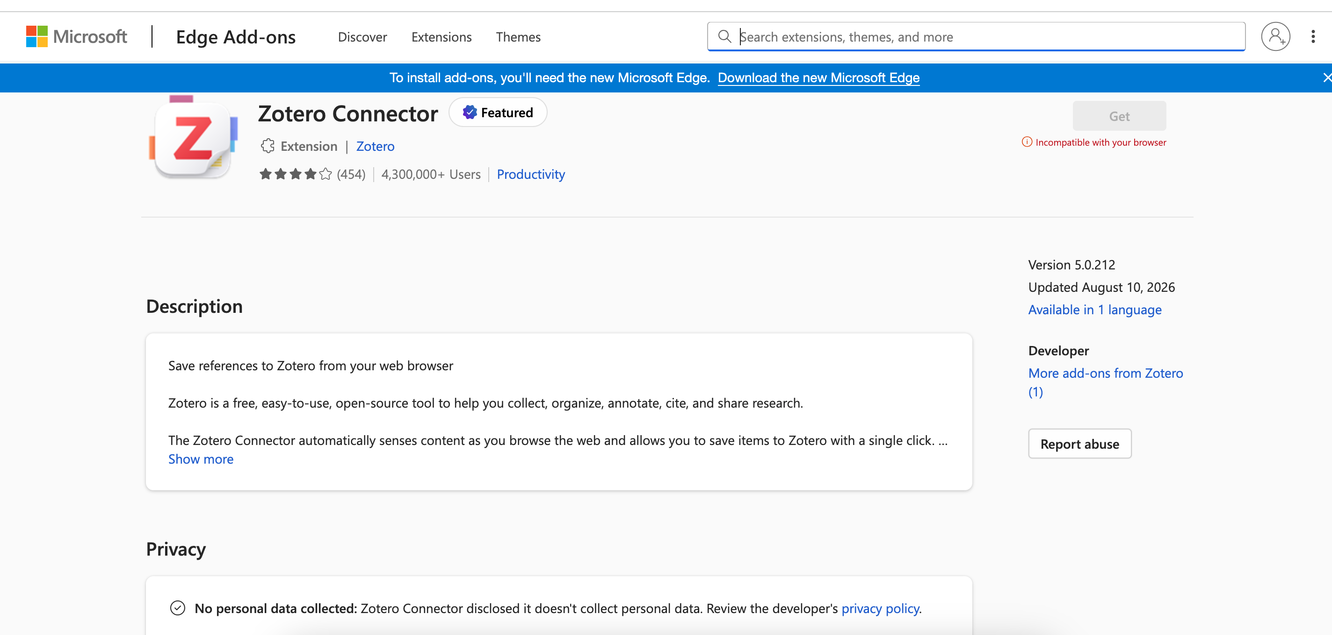
If you are a Microsoft Edge user … Zotero Connector - Microsoft Edge Add-ons
Unfortunately, not compatible with my computer model ... but should install the same as chrome connector

Slide 16
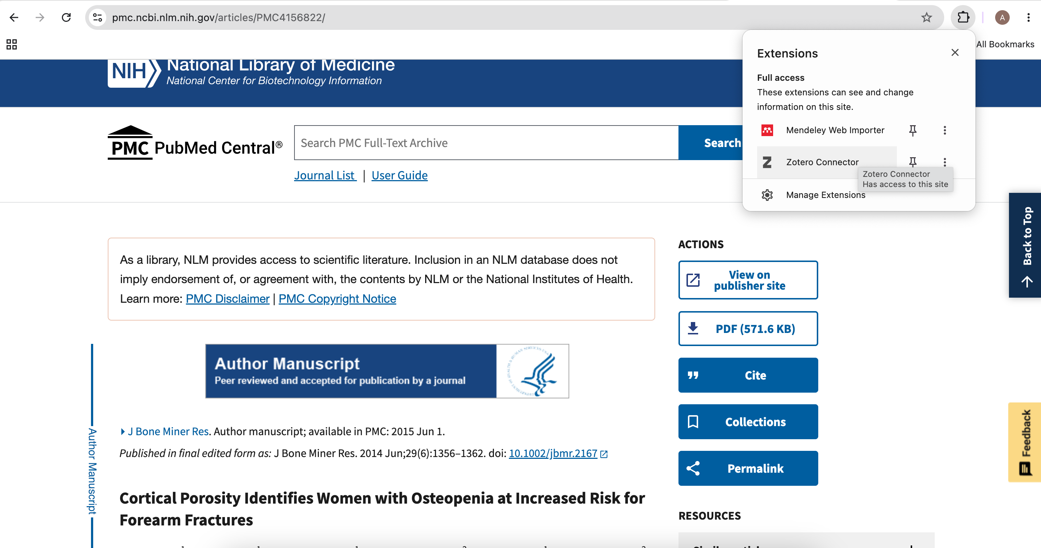
Check by adding a source – click the extensions in the top of browser
One example to add a reference = downloading the PDF

Slide 17
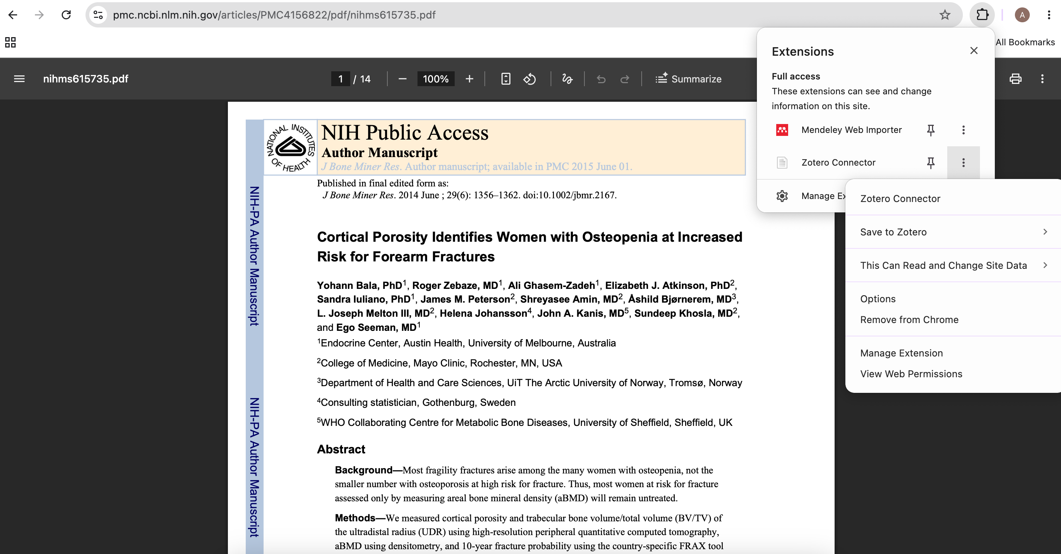
Click three dots then "Save to Zotero"

Slide 18
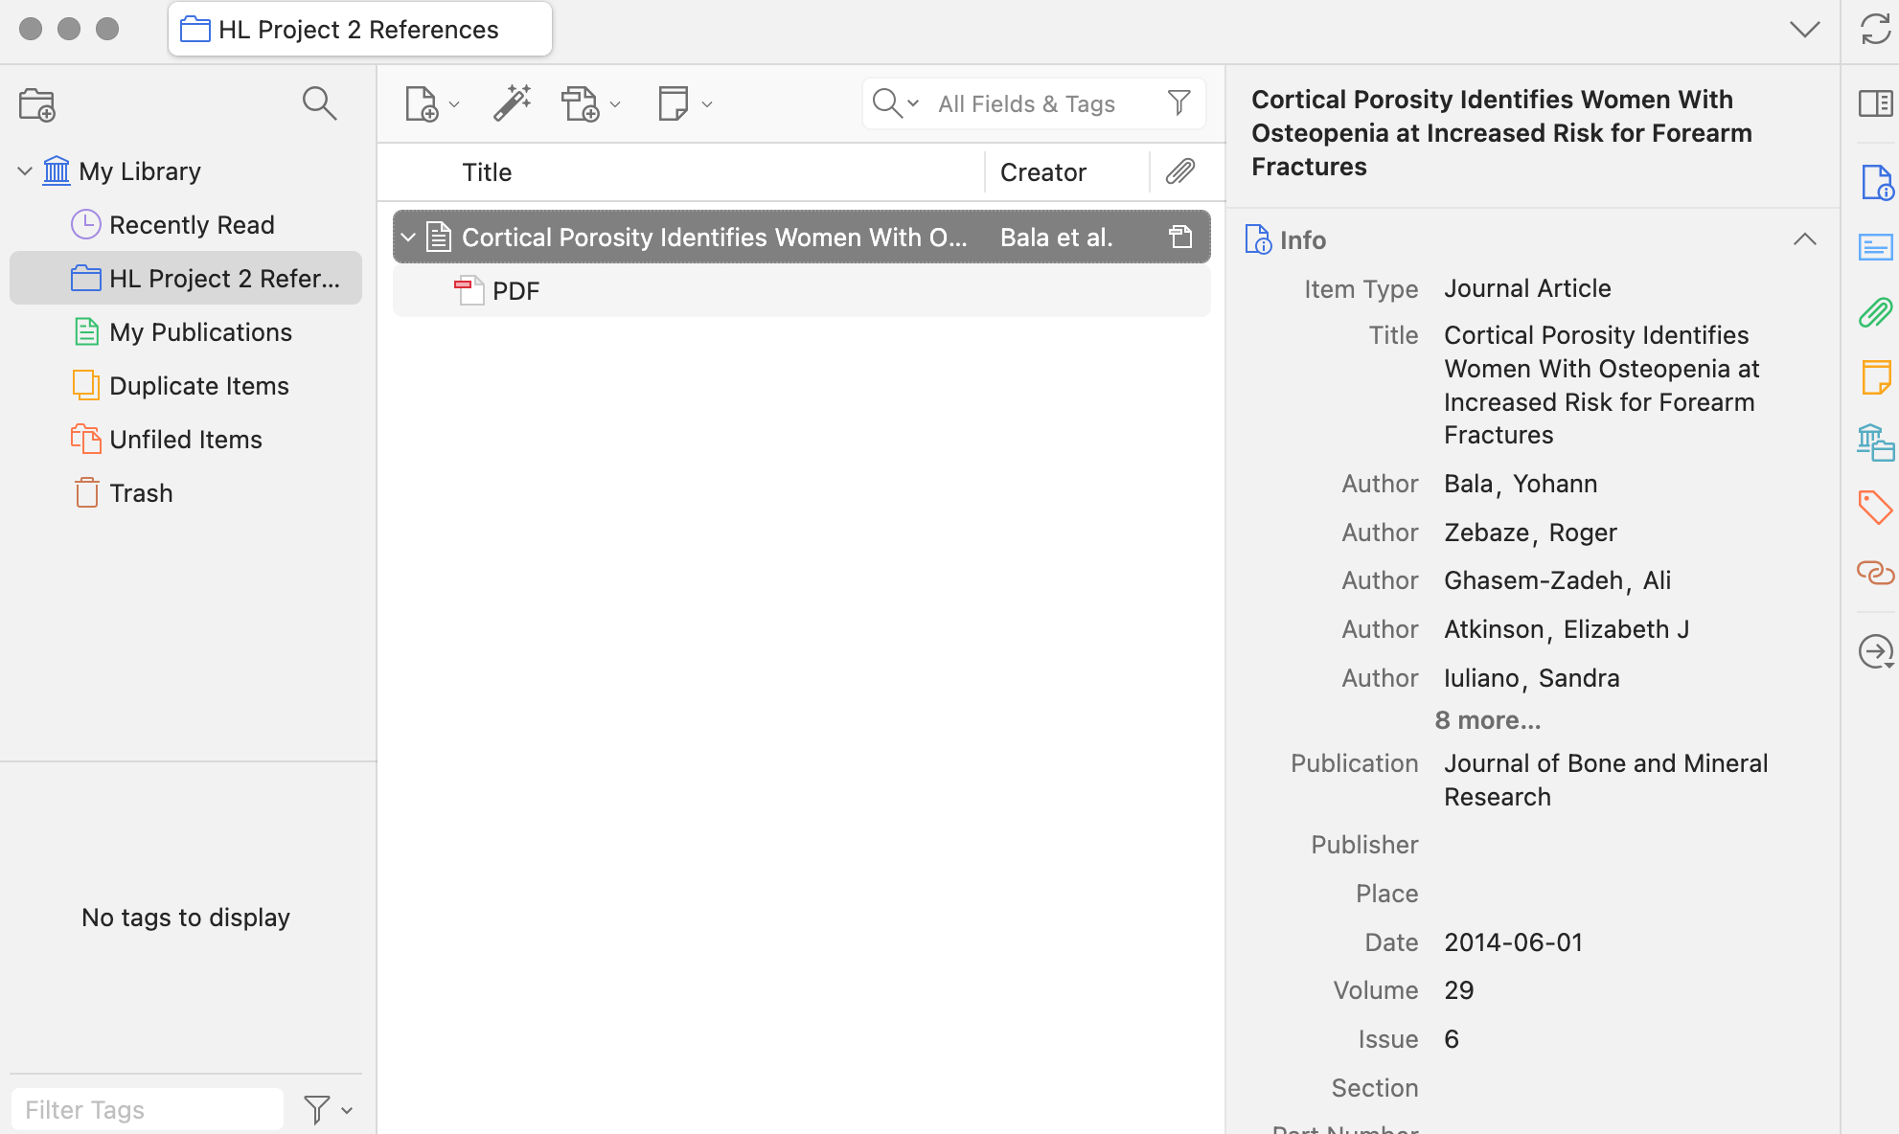
Go back to Zotero app – find the article with all information on the right along with the PDF

Slide 19
Word Plugin

Slide 20
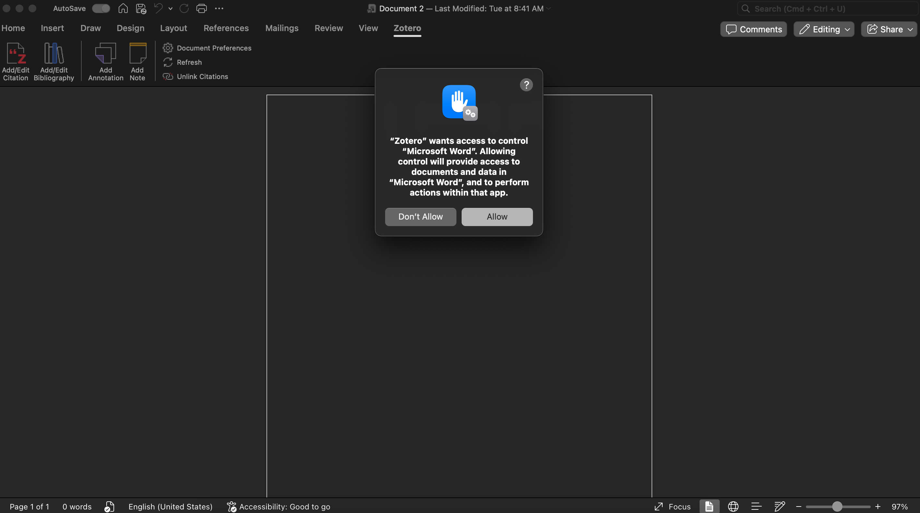
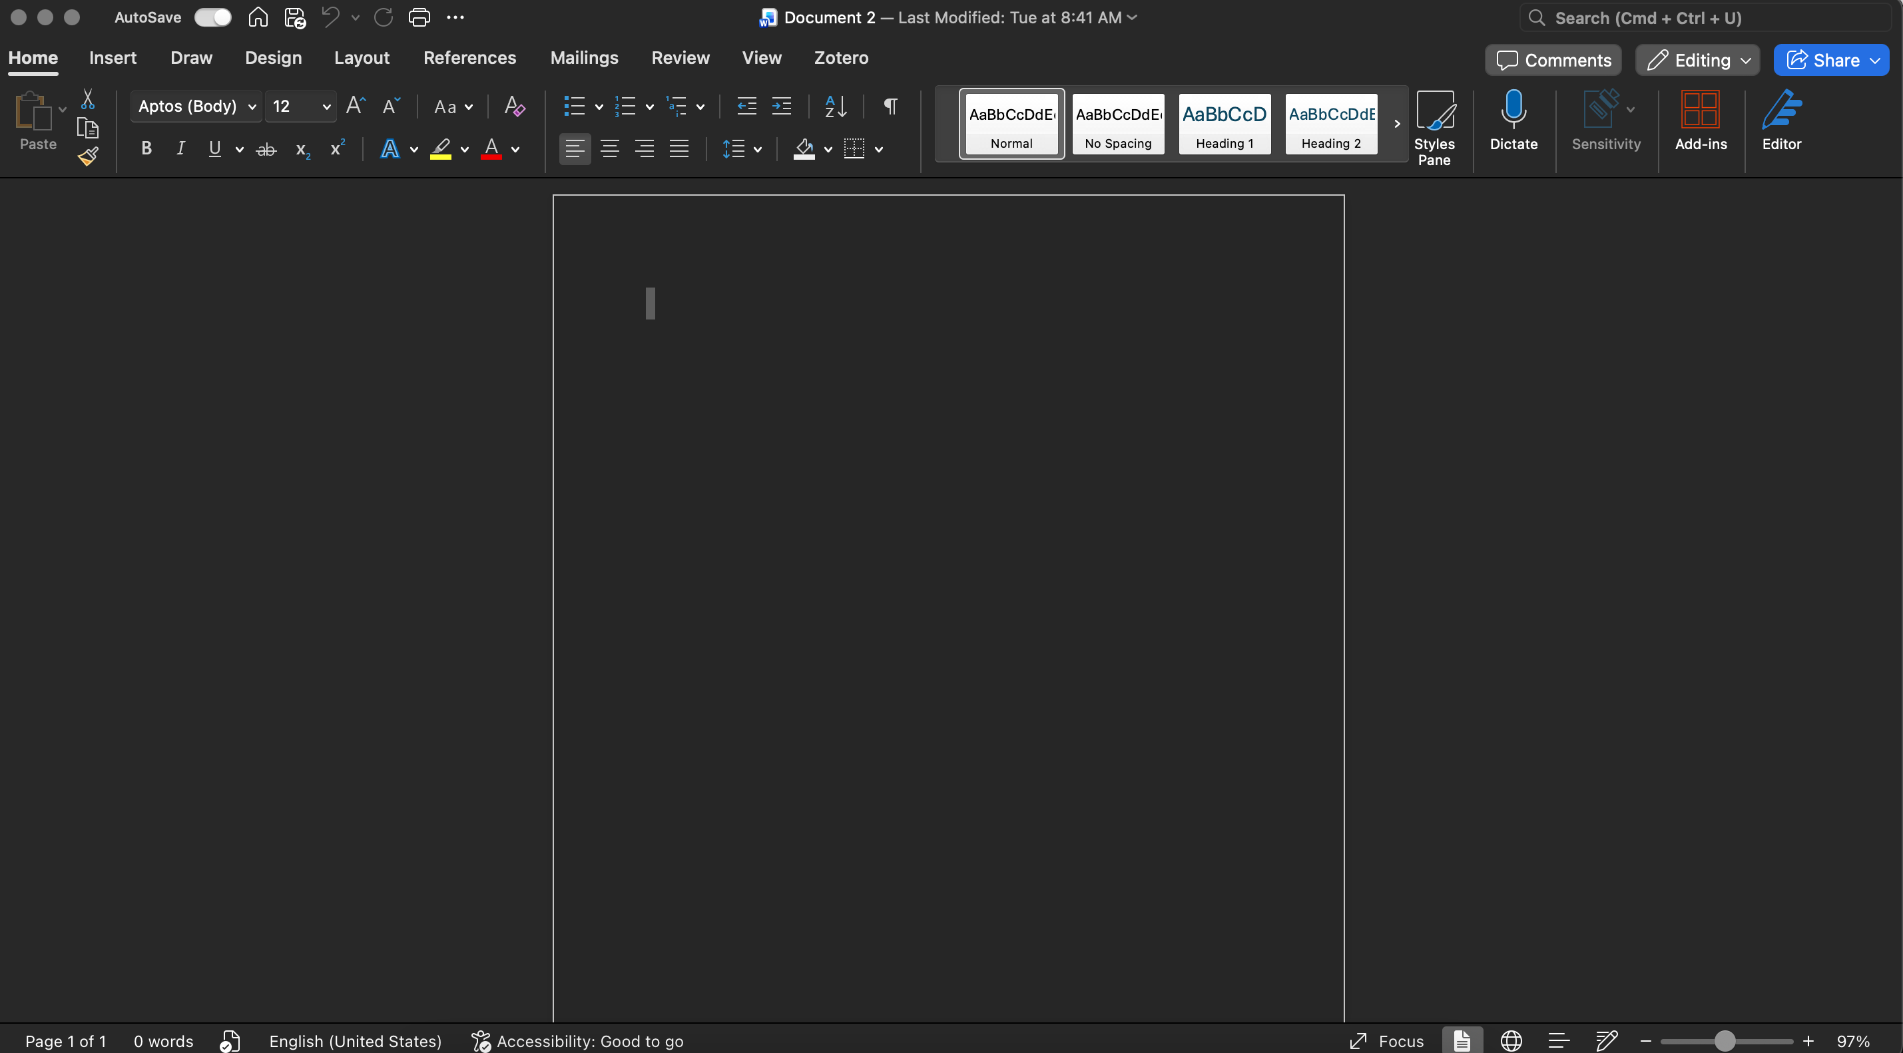
Word Desktop should already have Zotero plugin installed (from your original download)

Slide 21
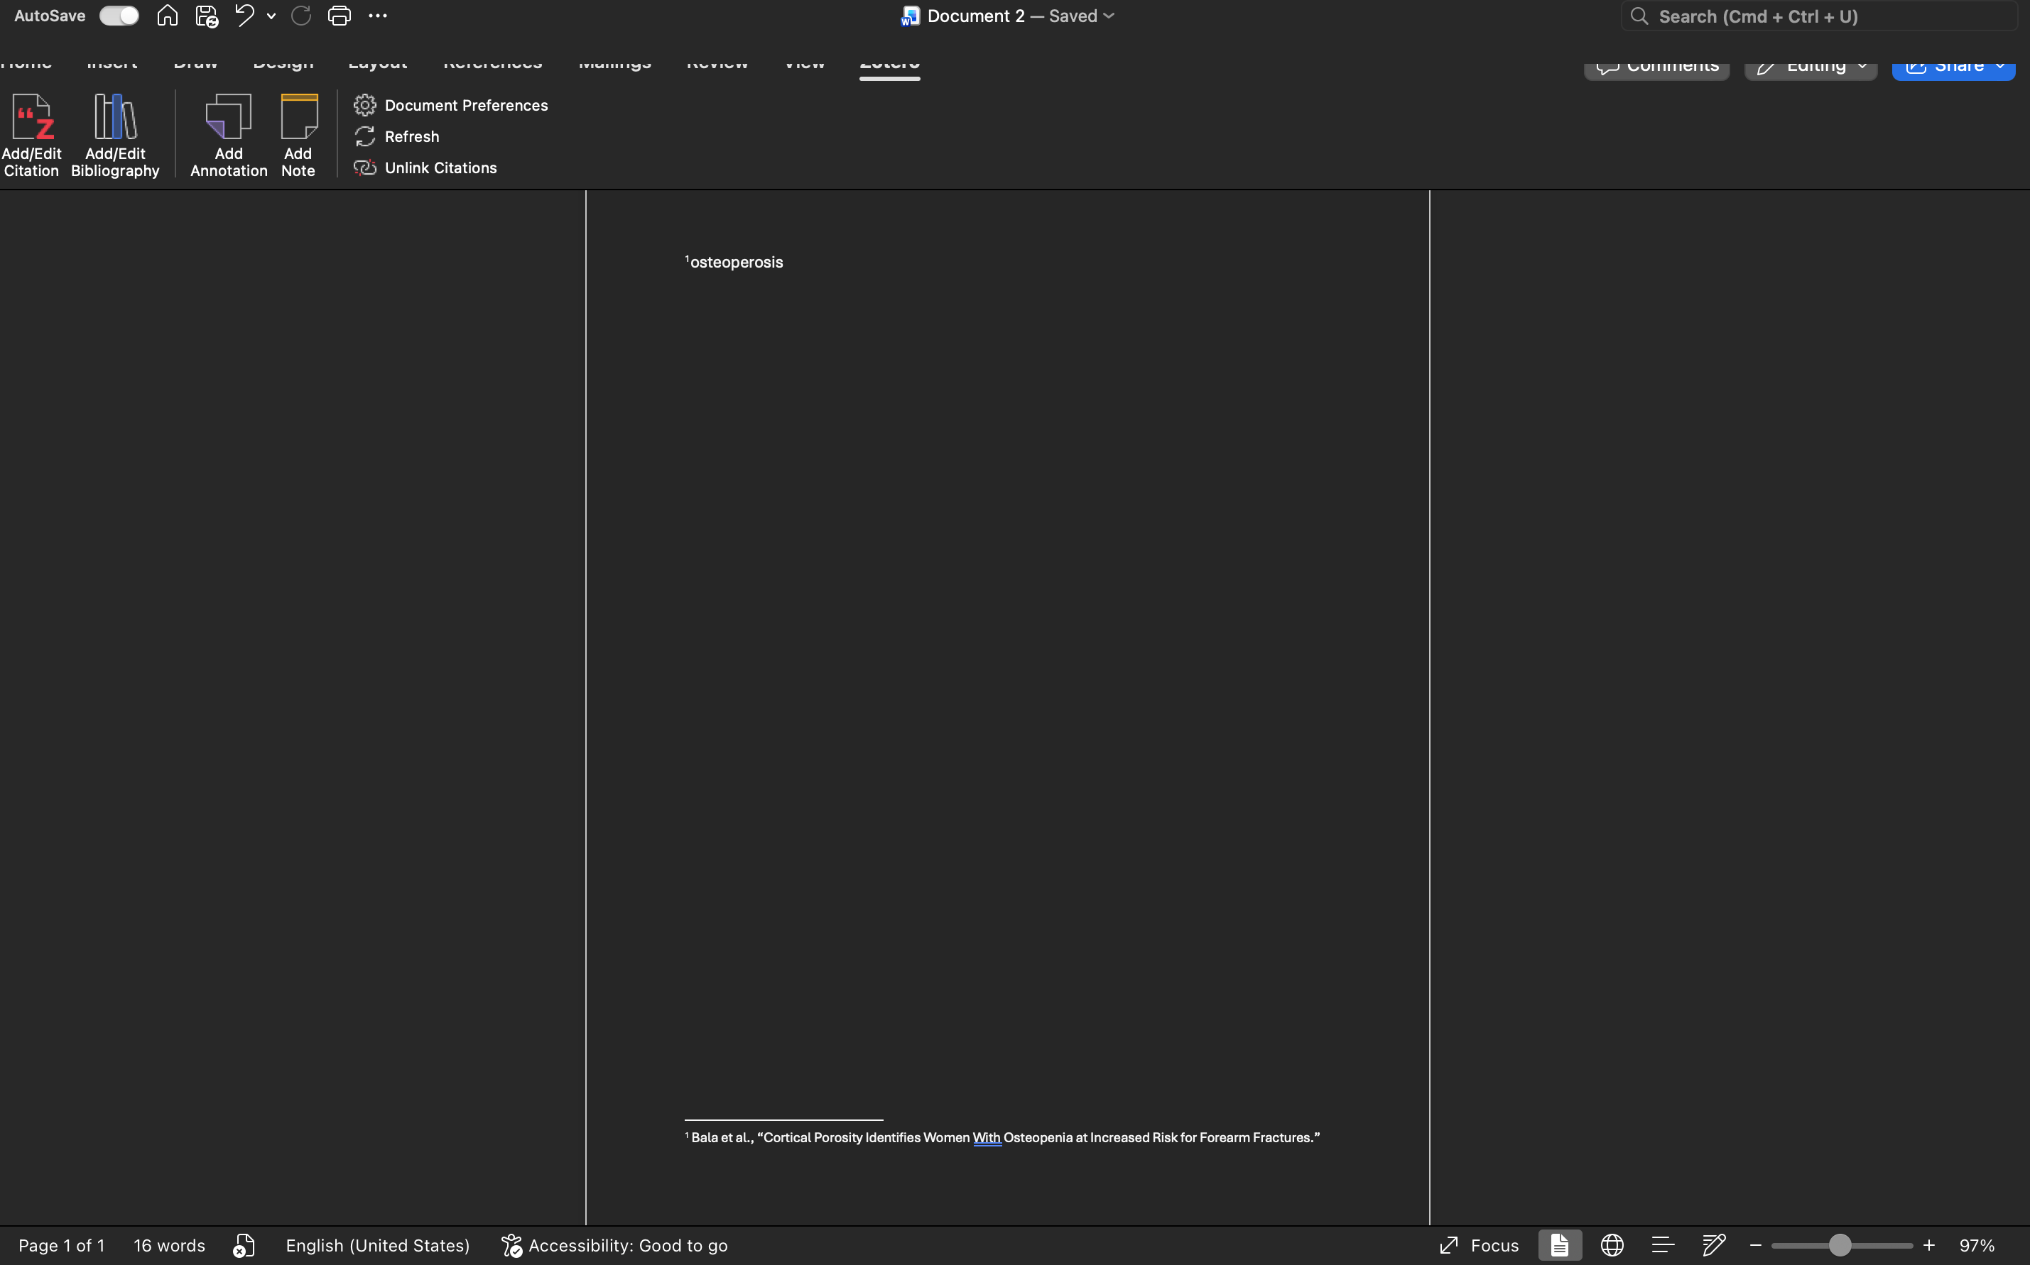
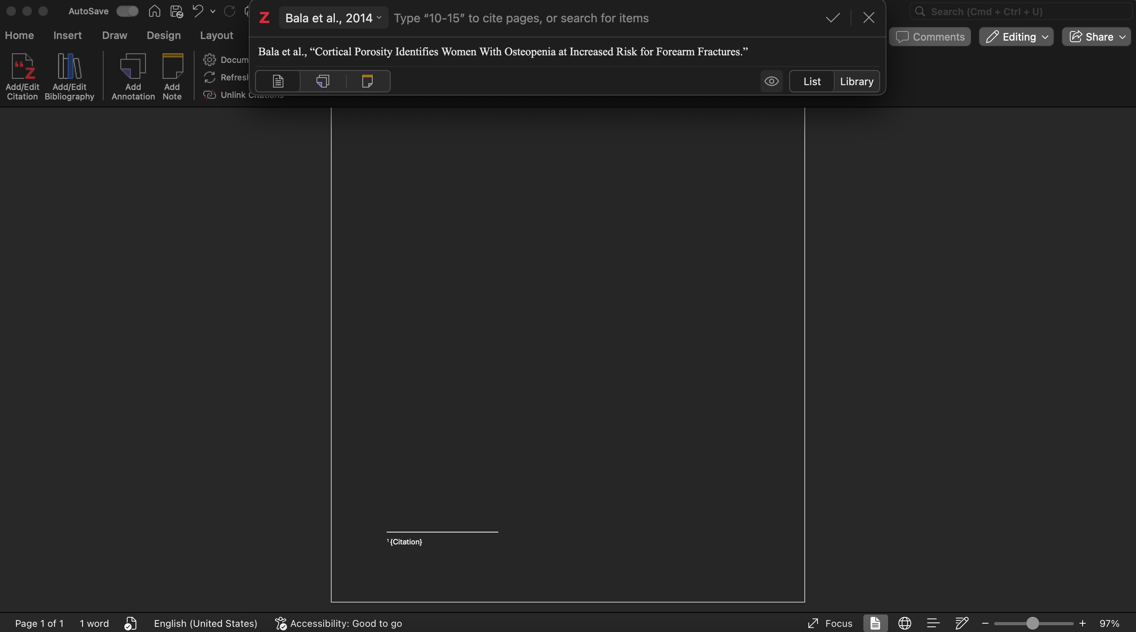
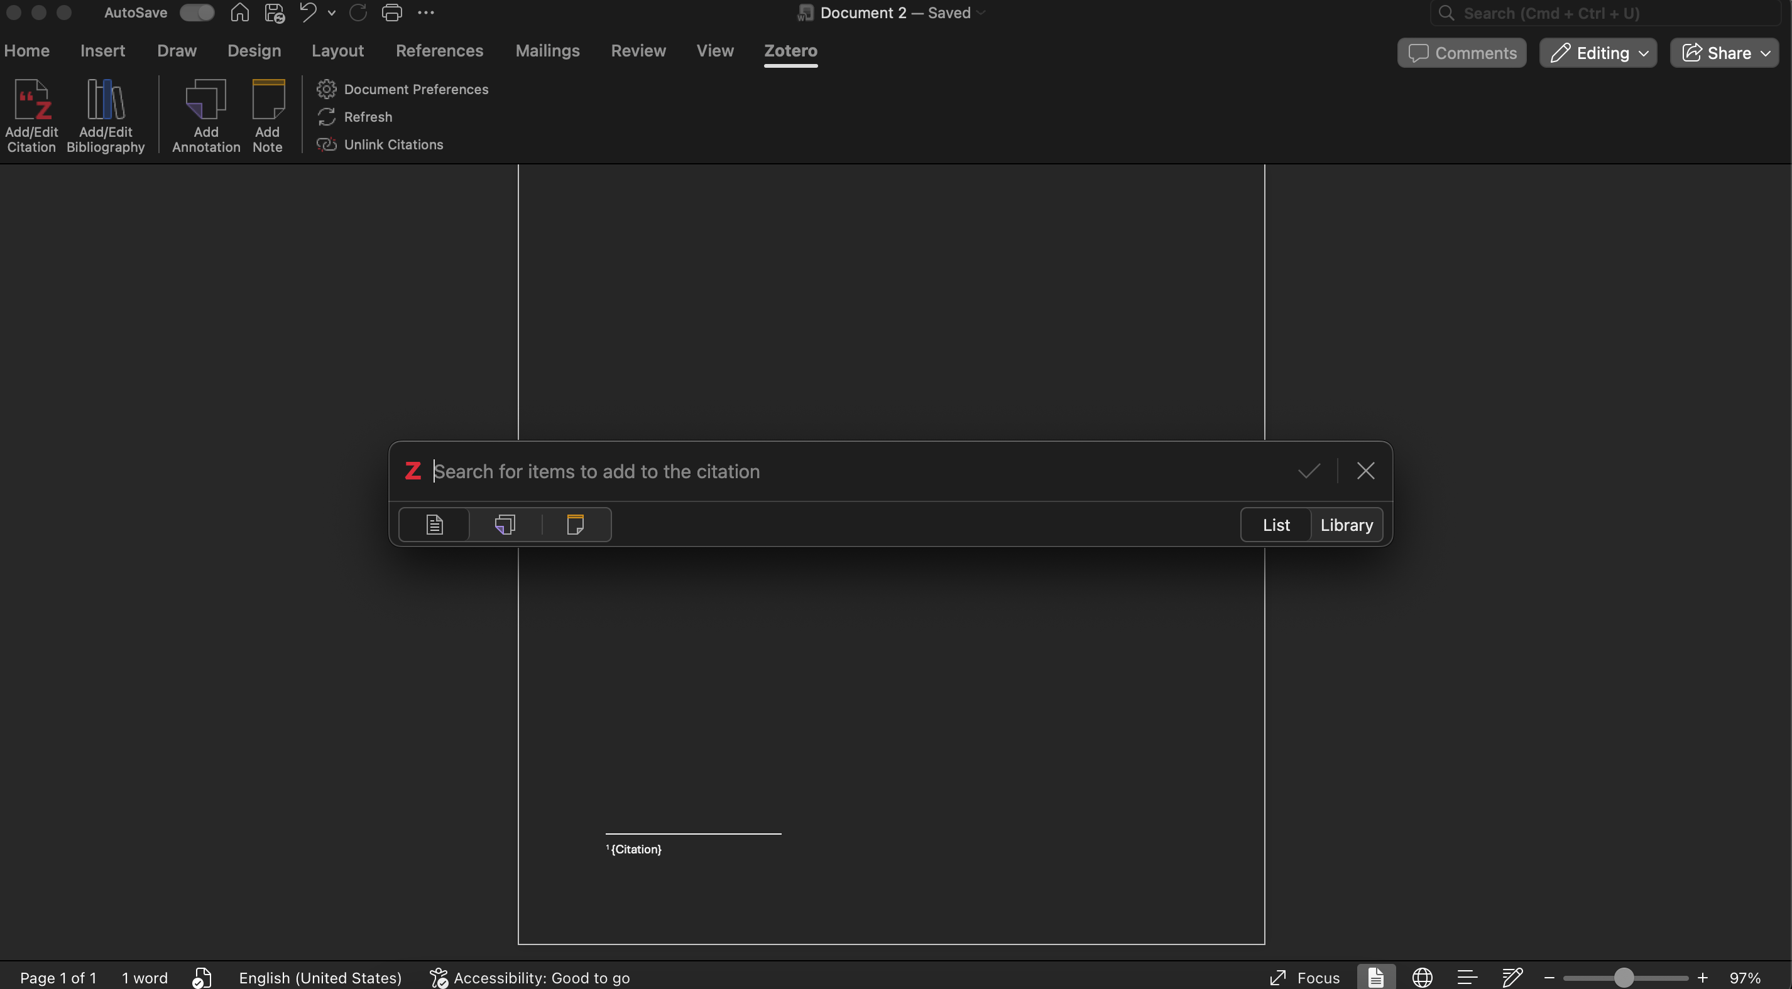
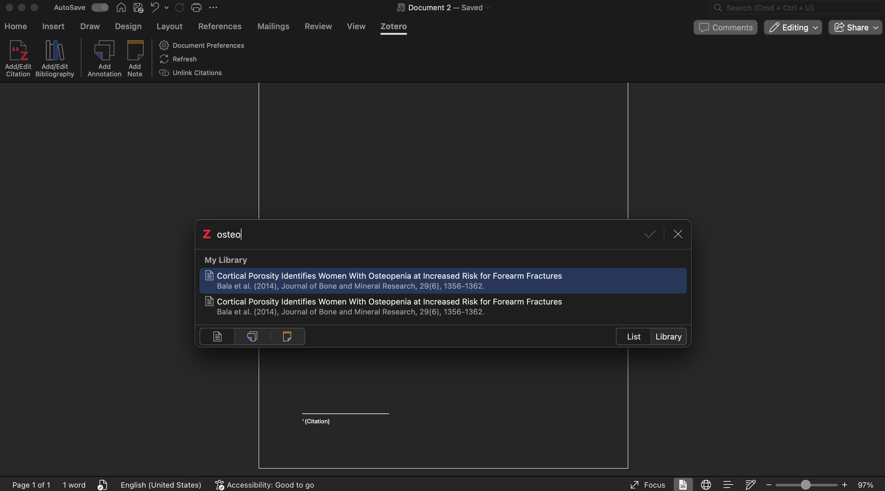
How to add a citation
Citation is added along with its footnote
Search the article name of the citation you want to add

Slide 22
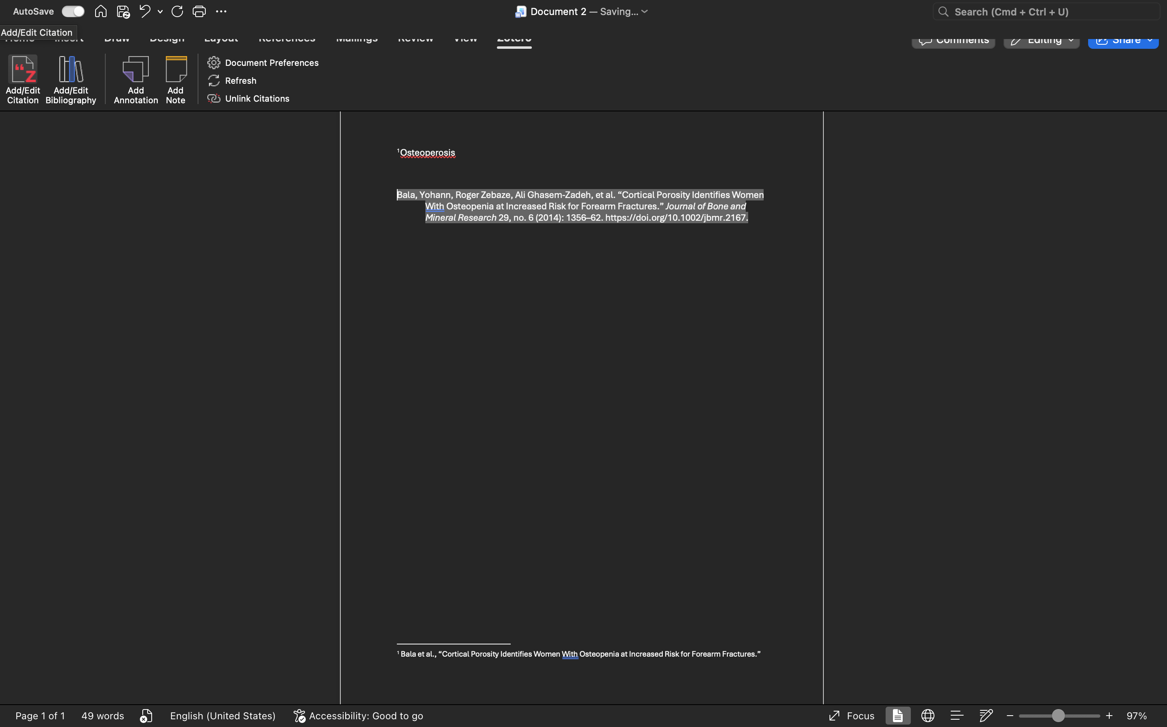
How to add a bibliography
Place Bibliography where it is wanted

Slide 23

Have Fun Reference Hunting!

