Slide 1
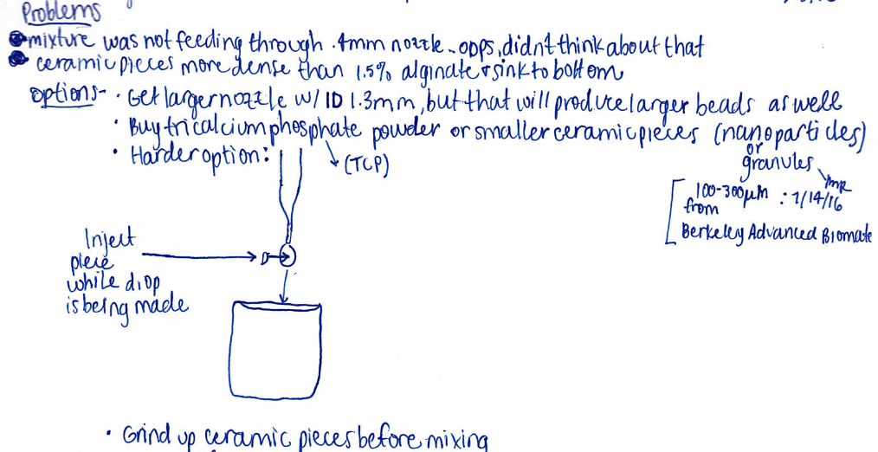
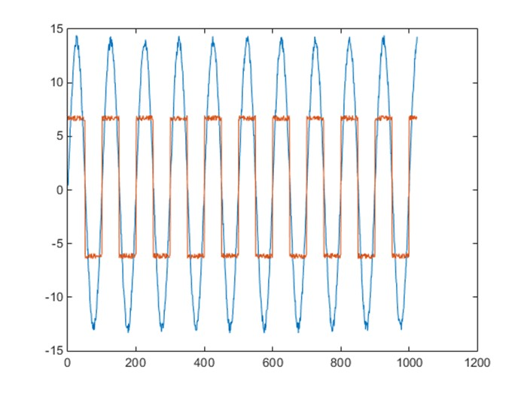
2/2/2020
Jodi Holliday
Research Student
2/2/2020
2/3/2020

Slide 2
Making PLA Beads
2/2/2020
Jodi Holliday
Organize using headers. What is the name of this experiment?
Procedure?
RS
2/2/2020
Never scribble through data
Strikethrough, initial and date
What is this part? Add label
Strike through blank lines
How? What size?
Research Student
2/2/2020
Need Title
Need signature on paper insert and notebook
Need labels for both axes
Electronic data should be archived (for example on a shared network drive) and referenced in the notebook
Legend
E:/shareddrive/experiment1/waveform2.dat
Should be countersigned by a witness
Research Student
2/2/2020
Another Student
2/3/2020

Slide 3
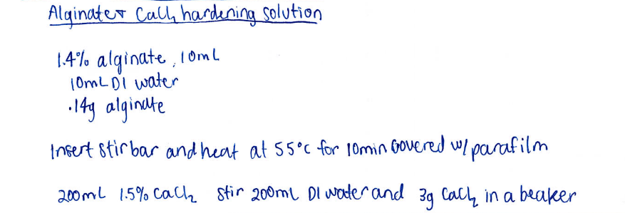
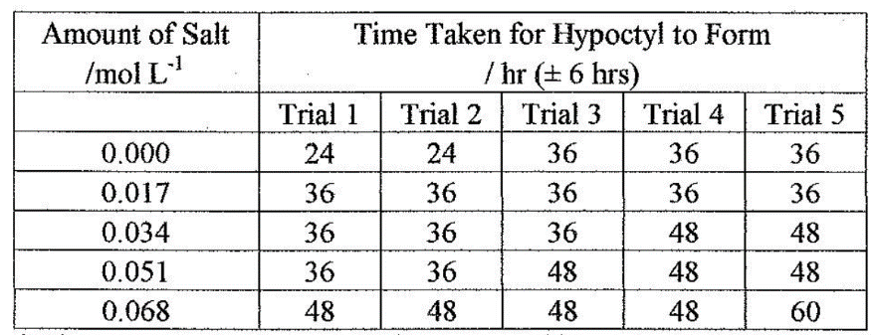
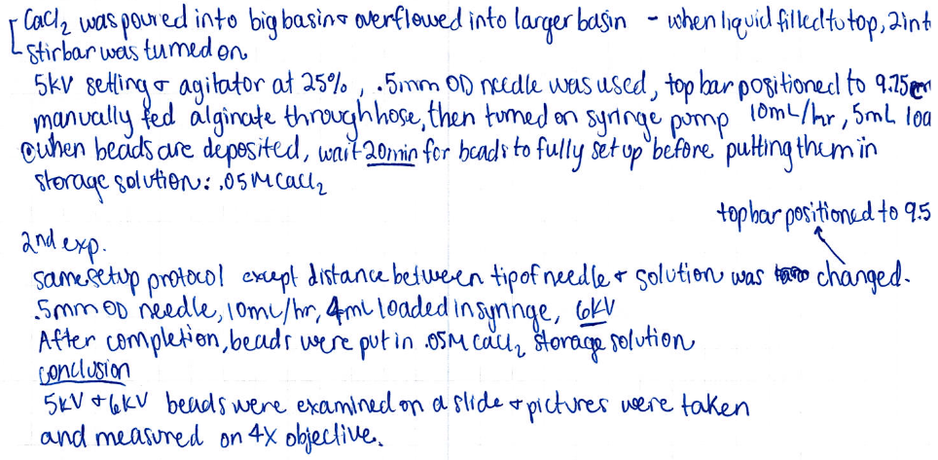
1/30/2020
Jodi Holliday
Research Student
2/2/2020
Another Student
2/3/2020

Slide 4
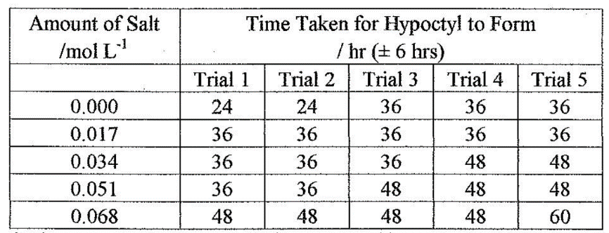
Making PLA Beads
1/30/2020
Jodi Holliday
Name of experiment
Purpose
Purpose: To synthesize isoborneol from camphor.
Ref: SOP HL-23002020V1
References for example a Standard Operating Procedure (SOP) #
Strike through blank lines
Research Student
2/2/2020
signature is on paper insert and notebook
Sign it each day (waited several days here)
Research Student
2/2/2020
Another Student
2/3/2020

