Slide 1
Can I Chew Gum in the Lab?
No!

Slide 2
Regulations
Chemical Hygiene Standard 29 CFR 1910.1450
Appendix A - National Research Council Recommendations Concerning Chemical Hygiene In Laboratories (Non-Mandatory)
1. General Rules for Laboratory Work With Chemicals
k. Eating, drinking, smoking, gum chewing, applying cosmetics, and taking medicine in laboratories where hazardous chemicals are used or stored should be strictly prohibited.
Enforced by OSHA – Occupational Safety and Health Administration

Slide 3
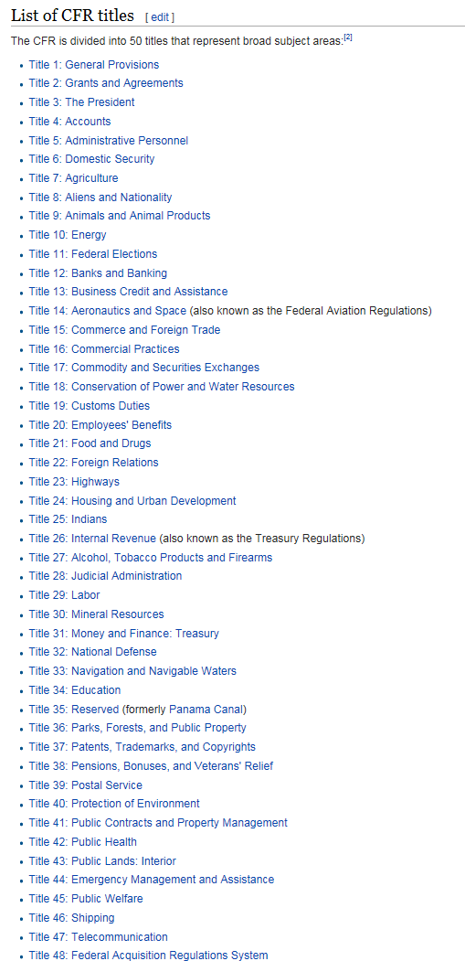
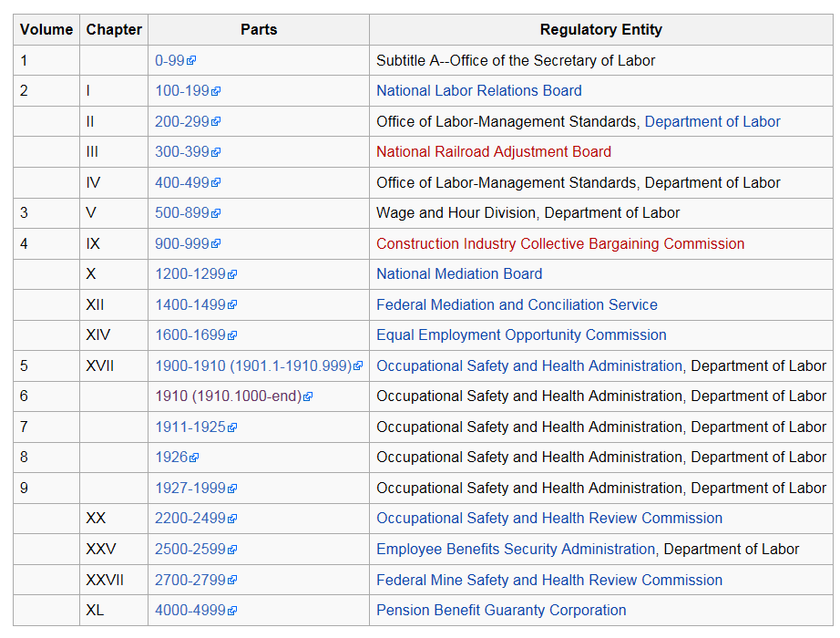
What is 29 CFR 1910.1450
Code of Federal Regulations (CFR) is the codification of the general and permanent rules and regulations by the executive departments and agencies of the federal government of the United States.
169,301 pages
Eating, drinking, smoking, gum chewing, applying cosmetics, and taking medicine in laboratories where hazardous chemicals are used or stored should be strictly prohibited.
Notes:
https://en.wikipedia.org/wiki/Title_29_of_the_Code_of_Federal_Regulations

Slide 4
Why This Prohibition?
Avoid cross-contamination and ingestion:
Airborne materials settling out or condensing on food surfaces and utensils
Consumable items placed on a contaminated surfaces
Contaminated gloves used to handle food

Slide 5
What if gum is placed into the mouth before entering the lab?
The answer is NO.
While you might be able to show the safety officer you are putting it in your mouth outside of the lab, you would not be able to prove that to an inspector.
Also, this opens the door to many potential problems if you allow a practice that essentially violates common lab regulation.

Slide 6
What if gum is placed into the mouth before entering the lab?
The answer is still NO.
When you chew gum you are tempted to smack or blow bubbles. May result in touching gum.
May distract you

Slide 7
Remember
NO eating, drinking, smoking, gum chewing, applying cosmetics, or taking medicine in laboratories

