Slide 1
REM Different Types of Research Articles
Department of Bioengineering
Institute for Biological Interfaces of Engineering
Clemson University
February 27, 2015

Slide 2
Types of Research Articles
Experimental Articles
Meta-Analysis Articles
Review Articles

Slide 3
Types of Research Articles
Experimental Articles
Experimental testing
Scientific communication about personal/lab group experiments
Experimental methodology

Slide 4
Types of Research Articles
Meta-Analysis Articles
Combination of multiple experimental results
Commonly from different groups/labs
Secondary data analysis to find trends

Slide 5
3. Review Articles
Summary of research data from a particular topic
Scientific communication analyzing others’ experiments
Meant to provide reader general overview of “state-of-the-field”
Can serve as starting point for exploring literature
Meant to give big picture of research area, may exclude some details

Slide 6
Components of Review Articles
Generally consist of:
Abstract
Introduction including statement of purpose
Relevance of particular research area
Breakdown of specific research questions
Figures that are examples of representative work
Discussion/future directions of research area
References

Slide 7
Why do we need Reviews?
Reviews help us to avoid having to reinvent the wheel
Can be used as a map through many experimental articles that can be found on a subject
Help point to “holes” in the literature—areas for improvement

Slide 8
Acknowledgments and References
Thank funding sources and individuals who may not have contributed as authors but did contribute
Acknowledge potential conflicts of interest
References critical because link all data behind review
Should include author information, article title, journal title, and year of publication

Slide 9
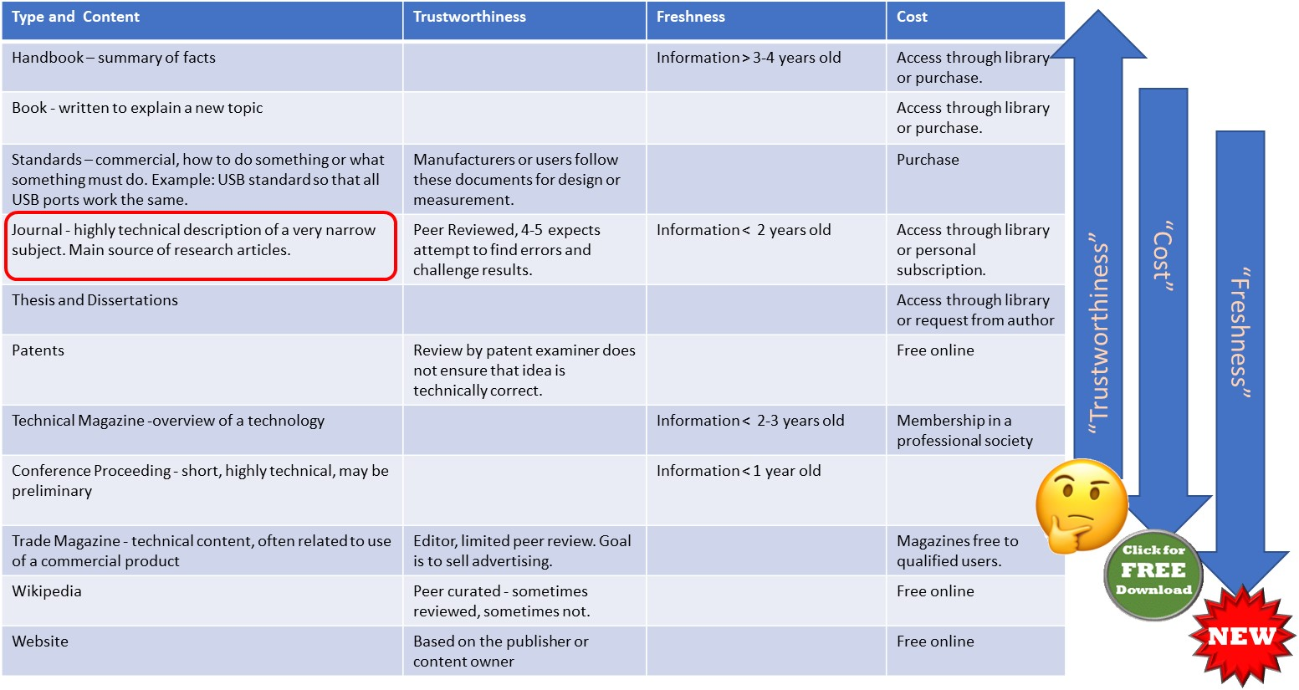
Sources of Research Articles

