Slide 1
REM Email and Social Media Etiquette
Created under NSF Grant: EAGER CBET 1451319
http://eqpoint.info/rem
Karen J. L. Burg, Ph.D.
kburg@uga.edu
University of Georgia

Slide 2
Outline of Topics
Professionalism
Communication
Highlights of Email
Notes on social media
Twitter - Who might read this?
Facebook – What should I share?
LinkedIn – You are always interviewing

Slide 3
Professionalism
No one told me I was training to be a professional !
I thought if I took the calculus, chemistry, physics, thermodynamics, …, then I would be a good chemical engineer.
This is only a portion of what I really needed to know to practice engineering.

Slide 4
Professionalism
You are training to be a professional
“entering a competitive workforce that demands strong communication, teamwork, and problem-solving skills.”
Skills must be learned and practiced
“recent surveys and reports describe college graduates as deficient in these skills.” ⇨ need to practice!
Do you expect to be a tennis player without practice?
"Do Bosses Give Extra Credit? Using the Classroom to Model Real-World Work Experiences“, KL Campana, JJ Peterson, College Teaching, 61(2), 2013

Slide 5
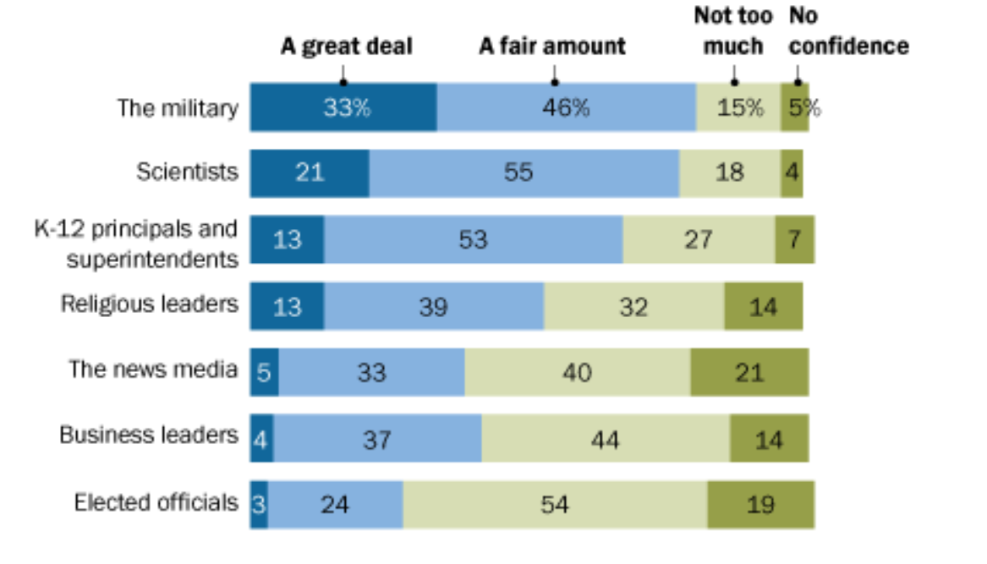
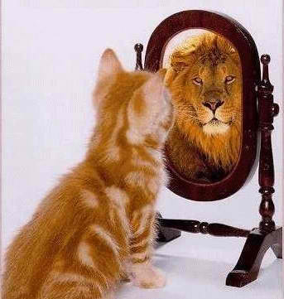
Professionalism
Perception is Someone’s Reality: You Must Manage Their Perception of You
http://www.pewresearch.org/science/2017/12/08/mixed-messages-about-public-trust-in-science/

Slide 6
Your Electronic Image
Communication Tools
Email
Twitter
Texting
…
Social Networking
Facebook
LinkedIn
Snapchat
…

Slide 7
Why Business Email?
Convenient
Simplifies reviewing and editing of documents
Makes some communication more succinct
Easy to keep team in the loop
Universal
Everyone has email
Can send an email that anyone can receive
Record of communications

Slide 8
Myth - Email is “Casual”
Email has a business purpose (if it doesn’t, don’t send it at work)

Slide 9
Myth - Email is “Casual”
Email message analysis is an important tool in modern litigation practice
Emails can be used to fill in details in a case
Federal prosecutors brought criminal charges accusing an engineer of deleting text messages related to the blown-out oil well in the Gulf of Mexico
http://news.yahoo.com/ex-bp-engineer-arrested-gulf-oil-spill-case-220848201--finance.html

Slide 10
Email Structure - Front Matter
Your Email is judged before it is read
“To”: are the right people included?
Recipients will assume that someone else will respond if they see a big list
Should be directed to the decision makers and stake holders
“CC” and “BCC”
BCC’s can become public
CC does not imply action needed, implies fyi

Slide 11
Email Structure - Front Matter
Subject should reflect purpose
Subject should entice recipient to read. Use meaningful subject as “hook”
Subject should be search friendly
Which would you read?
“Our supply chain problem”
or
“Proposal to solve supply chain problem”
http://pcs.ieee.org/six-tips-for-effective-e-mail/

Slide 12
Email Structure - General Content Rules
What action are you requesting? What do you want to result from your email?
Most people will only read the first paragraph.
three paragraphs is maximum recommended email

Slide 13
Email Structure - General Content Rules
Define a specific course of action
Please respond
Please forward to…
Please confirm when complete
Avoid abbreviations (u, 2), emoticons
Reserve “hey” for friends and informal communication
Use appropriate titles
Err on side of caution (Dr., not Ms.)
Be succinct

Slide 14
Email Structure - General Content Rules
Review and think before you send
Spell check
the “curtesy” email
Humor can offend, avoid forwarding jokes
Forwarded mail becomes associated with your name.
Ask yourself, “would I mind if this was accessible to all on yahoo?”
Professor offers tobacco company to place pro-smoking articles in the press (for a fee). Email to tobacco company leaked. Professor’s morals and values called into question.

Slide 15
Email Structure - Footer
Timothy Burg, Ph.D.
Professor, Department of Veterinary Biosciences & Diagnostic Imaging (VBDI)
Director, Office of STEM Education (OSE)
email: tburg@uga.edu
cell phone: (864) 506-0673
VBDI Office:
501 DW Brooks Drive, H374 Vet Med 1
College of Veterinary Medicine
The University of Georgia
Athens, GA 30602-7382
United States
Office phone: (706) 542-6574
VBDI department office: (706) 542-8310
General credentialing -
who you are
Contact Information

Slide 16
Email and Your Advisor
Define your mode and communication expectations
No 24-7 expectations
Be responsive, set 24 to 48 hr turnaround limit
Do not substitute email for personal interaction
Use to
Clarify expectations
Provide regular updates
Communicate problems

Slide 17
Electronic Data Lives Forever!
Once It Has Disappeared into the Ether, It Will Stay There Forever - Computer Weekly, 2002
Assume everyone can see your posts

Slide 18
Twitter
Conner had a job offer from ** on the table. She tweeted: “** just offered me a job! Now I have to weigh a fatty paycheck against the daily commute to ?? and hating the work.”
Shortly after a response was sent, “... We here at ** are versed in the Web.”
What do you think happened?
http://www.businessinsider.com/twitter-fired-2011-5?op=1#ixzz2bOYybRWF

Slide 19
Facebook
Do not talk about your work, advisor, supervisor, employer
Posts are stored and controlled by social server
Content is screened by employers
Post with care – friends can post and re-post
Monitor privacy settings, but ask…”what would this look like if everyone could read it?”

Slide 20
Facebook
Be wary of providing too much personal information
Company, personal confidentiality
Use to your advantage, provide professional content
Be selective in profile photos
Be discussion wary

Slide 21
Facebook
“Facebook Engineer Fired For Using Facebook Way Too Much At Work”
“I called in sick so I could go to the bachelor party and then again the day after, but a groomsman checked me in on Facebook Places and then tagged photos of me.”
You don’t control your online profile!
http://jamietalbot.com/2011/06/15/facebook-engineer-fired-for-using-facebook-way-too-much-at-work/

Slide 22
LinkedIn
More than 238 million members
“Gone are the days of “post and pray’” when recruiters hope that good candidates swim up to the bait; recruiters actively search
Keep credentials and profile photo up to date
You must use e-tools.
You must use them effectively.
http://www.washingtonpost.com/business/capitalbusiness/linkedin-has-changed-the-way-businesses-hunt-talent/2013/08/04/3470860e-e269-11e2-aef3-339619eab080_story.html

Slide 23
General Points
Know what’s affiliated with your name (not necessarily you, but your name)
Credit reports, arrest records, etc.
Post may be a permanent reflection of your identity that may never be erased
Nothing is really secret

Slide 24
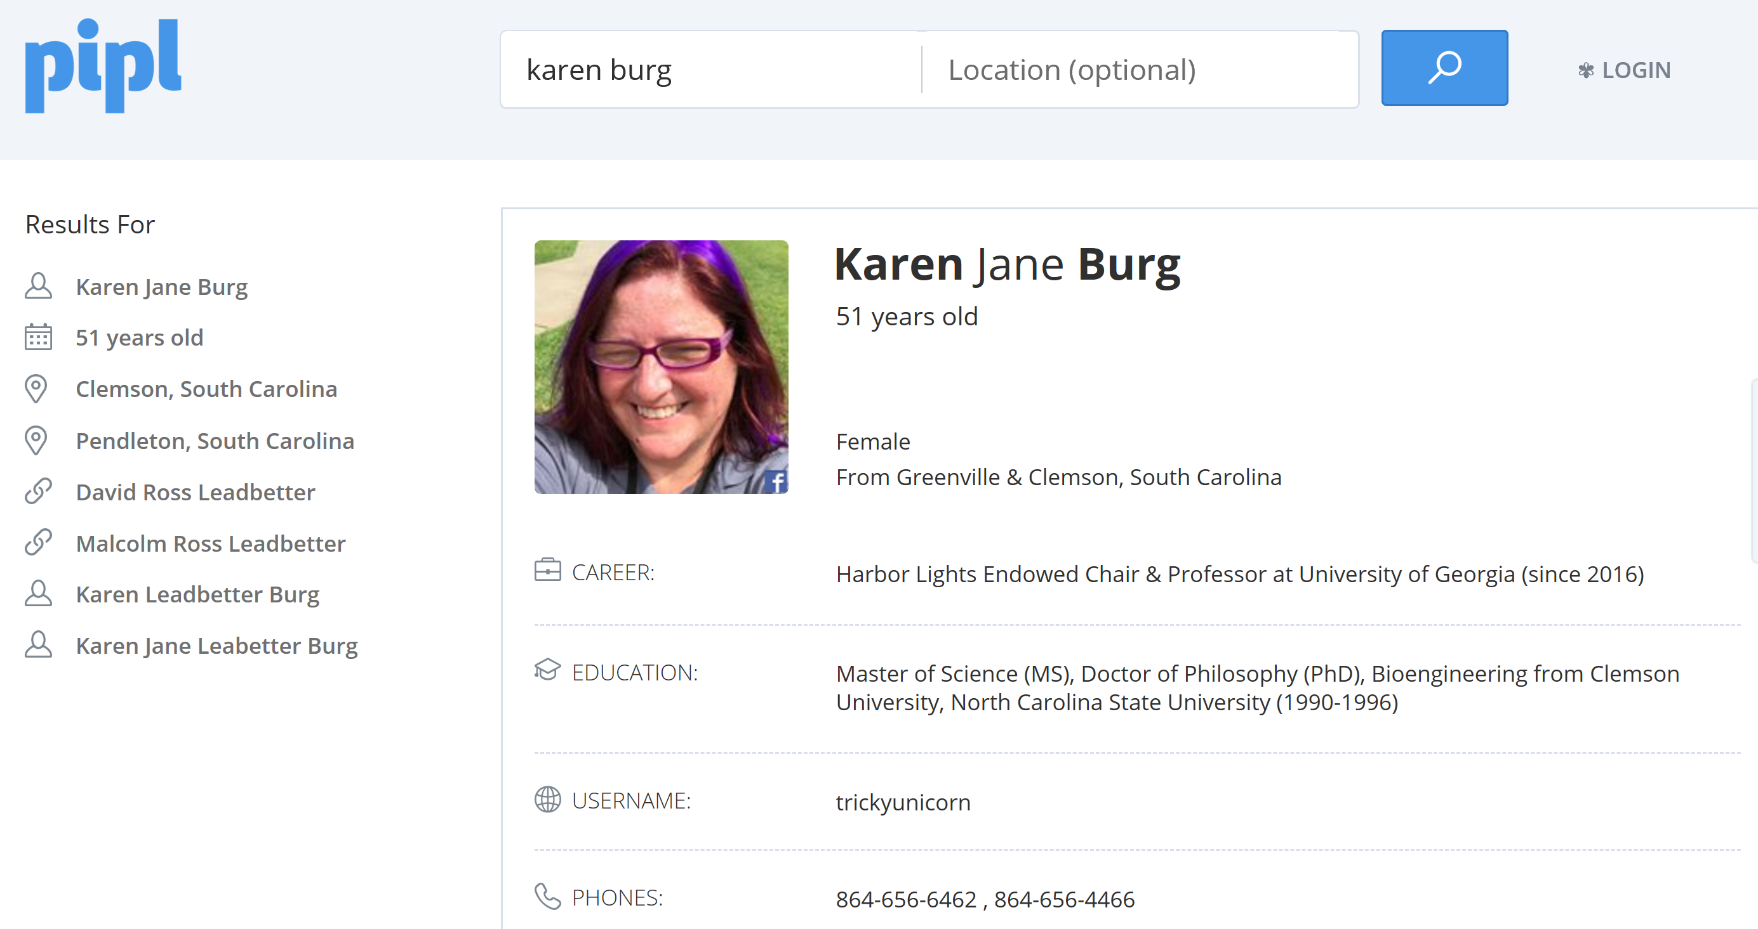
www.pipl.com
Old
Definitely Not!
Old

